Slide 2
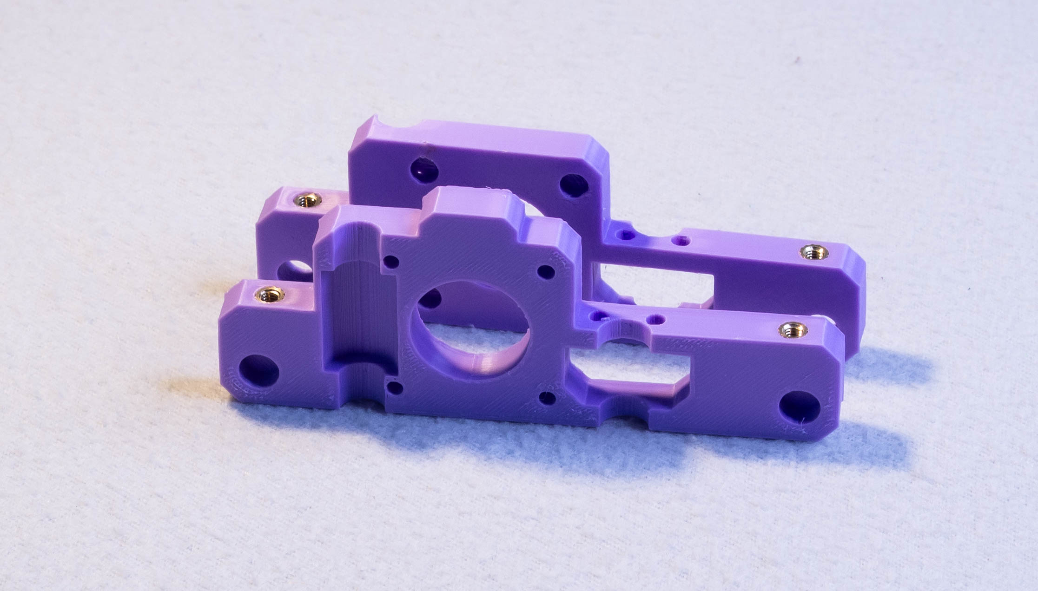
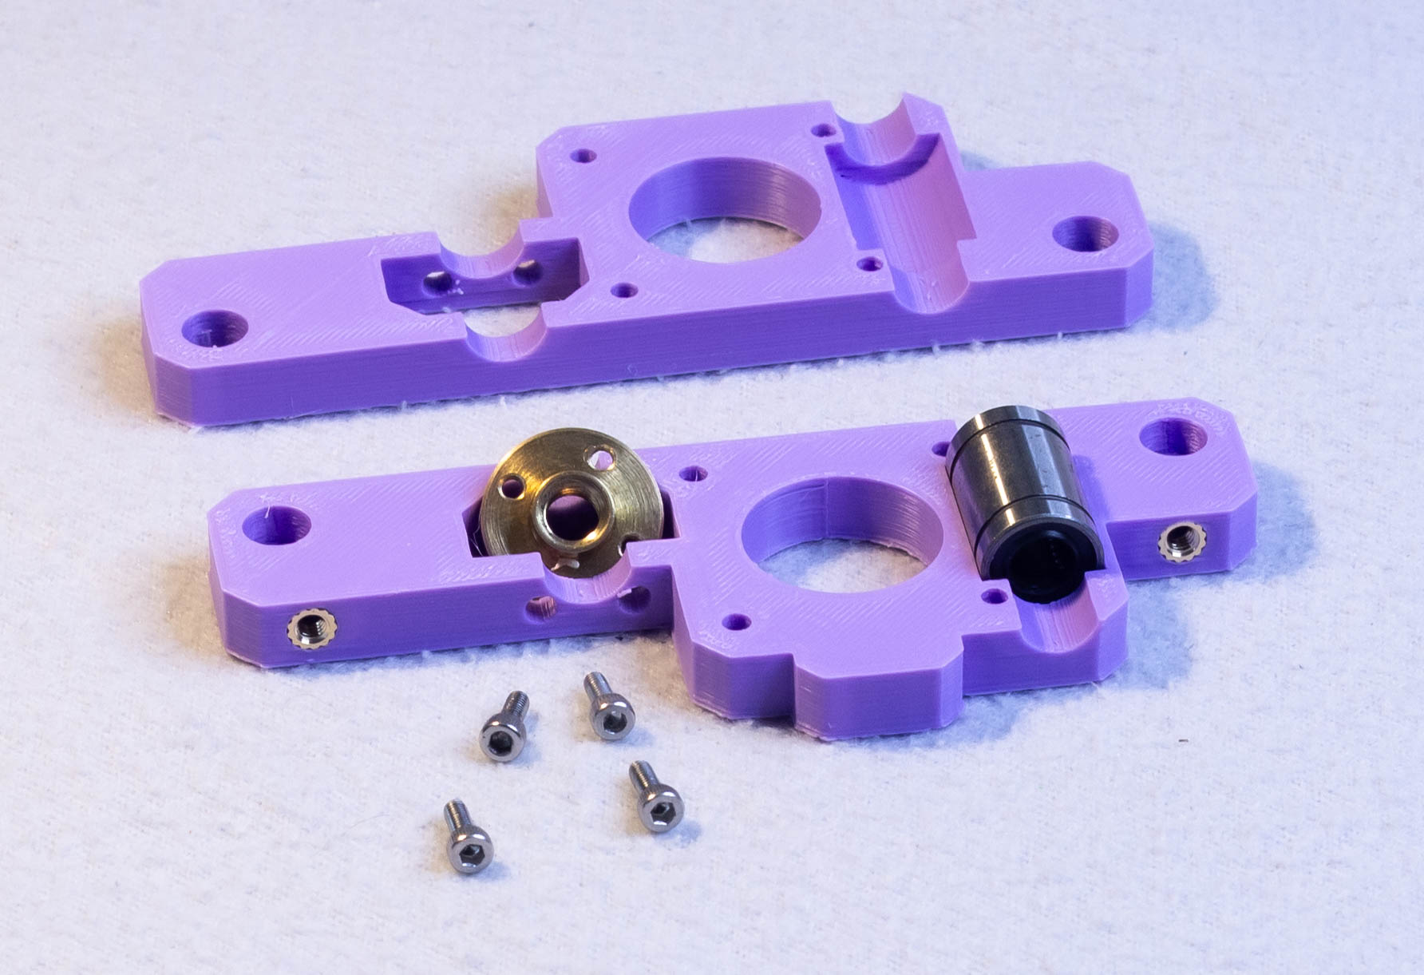
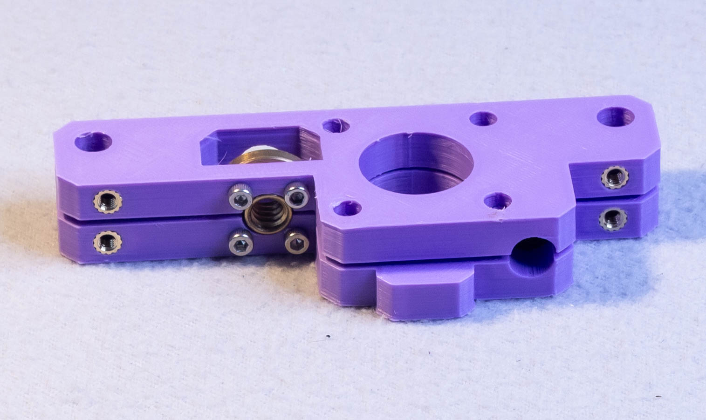
Step 1 – Base plate
M4 heat set insert *4
T8 Nut
M3x8mm *4
8mm linear bushing
(LM8UU 8x15x24mm)

Slide 3
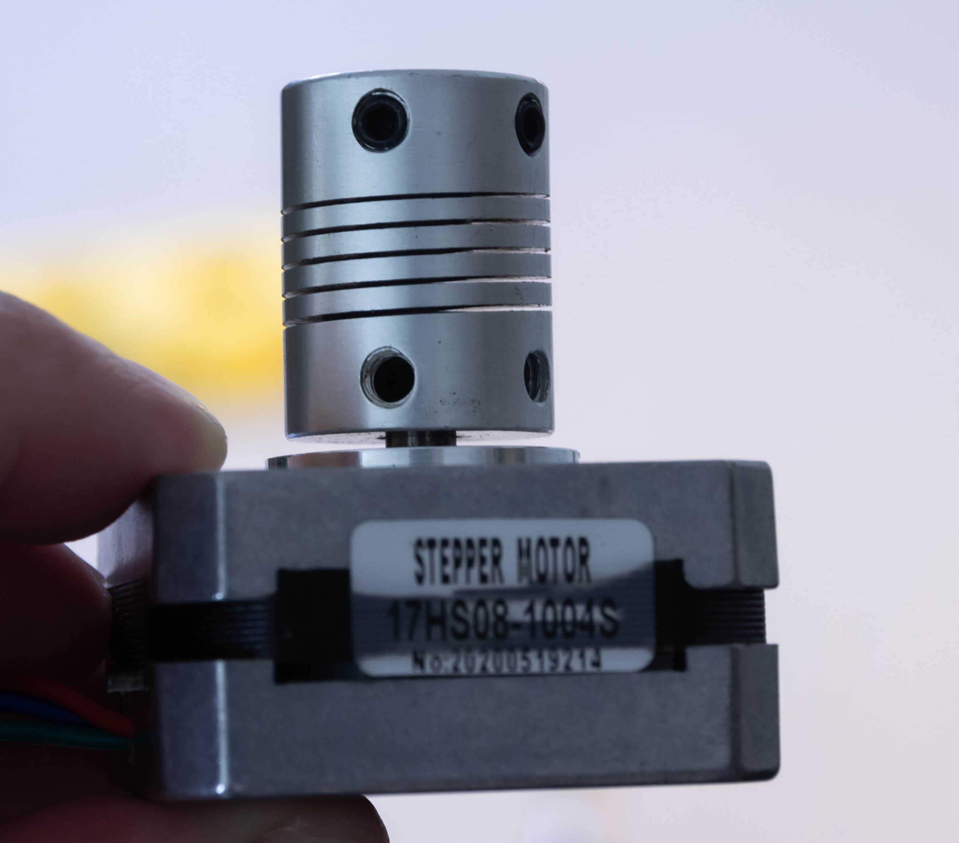
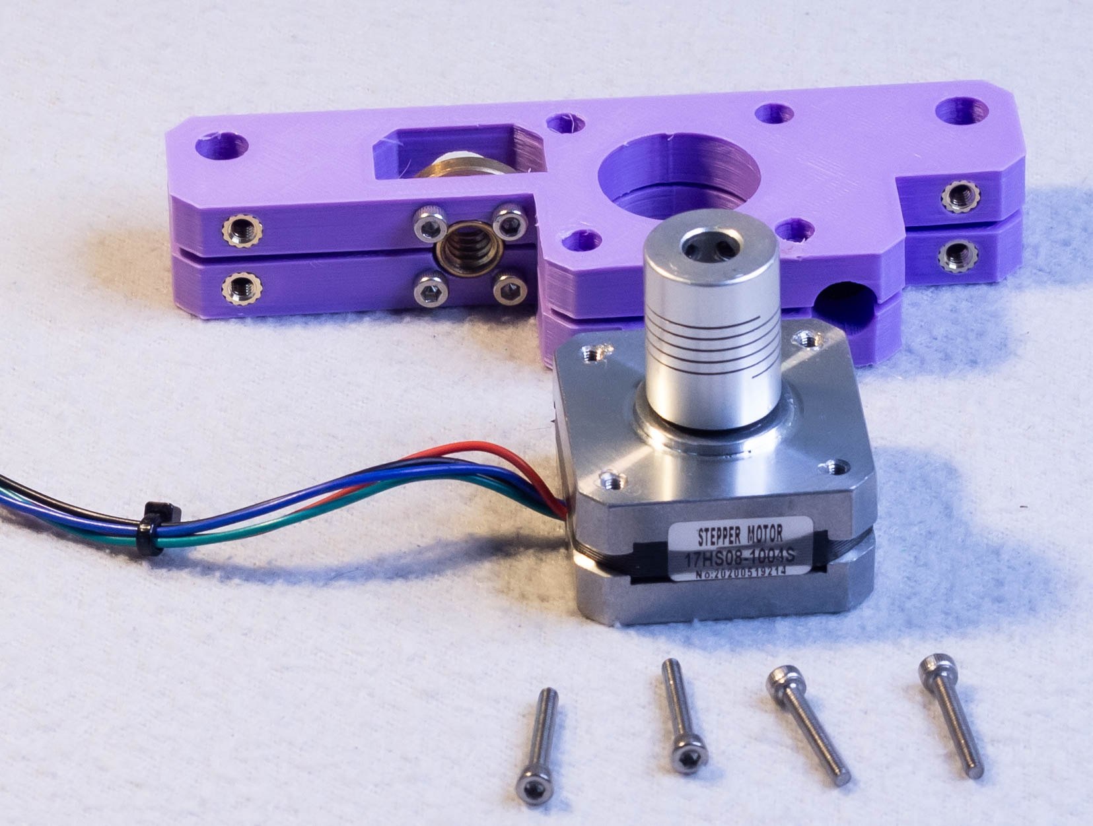
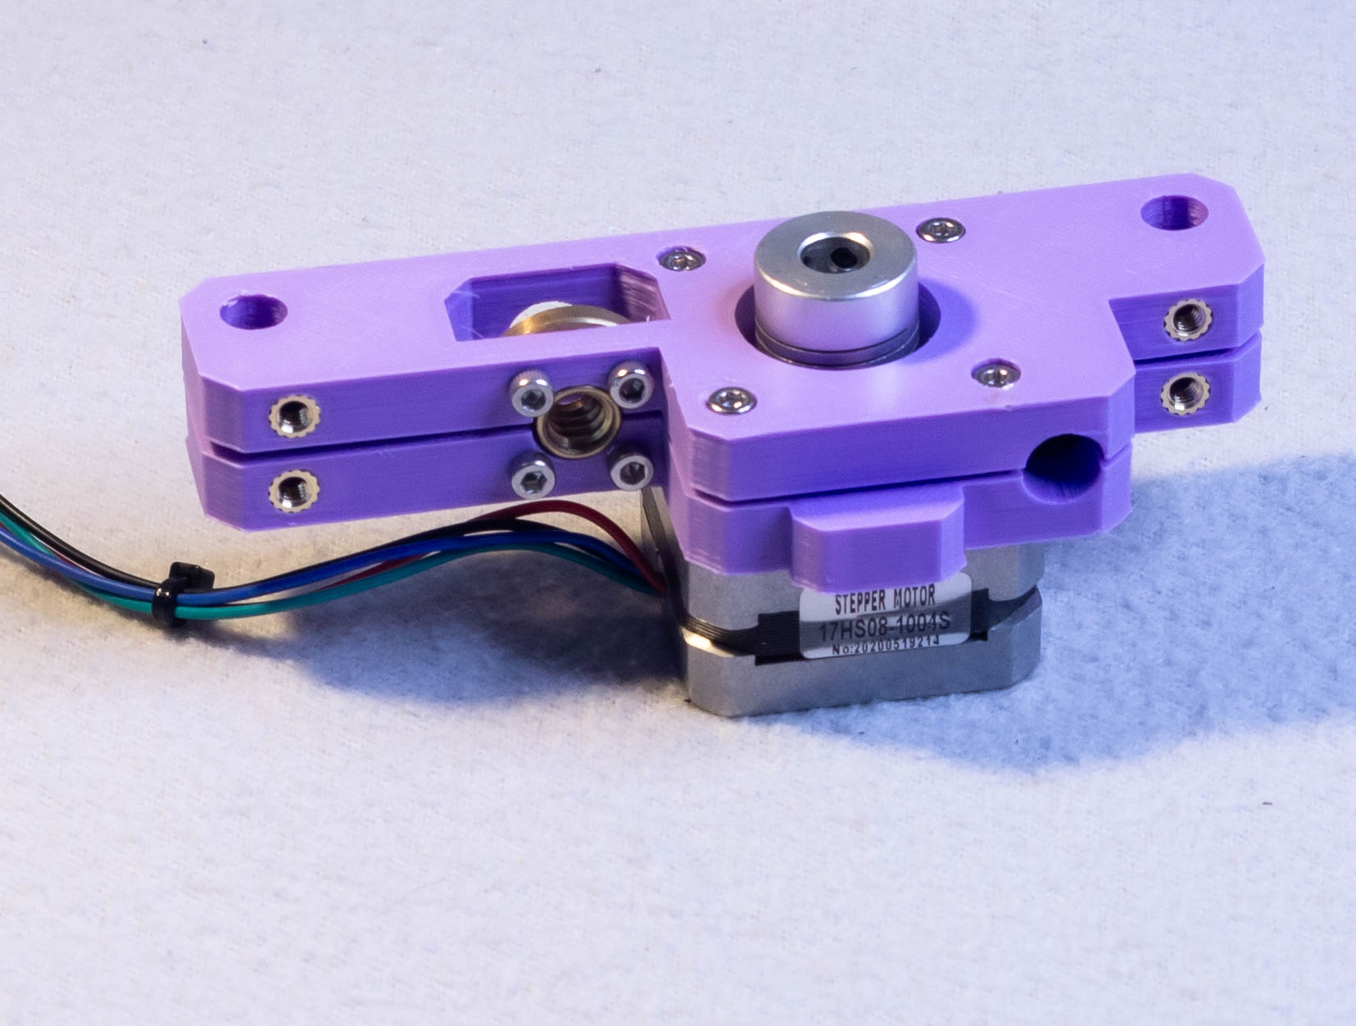
Step 2 – Focus Motor
Stepper motor
5 to 8 mm coupler
Be sure to mount coupler with a gap so it doesn’t rub against the motor
M3x10mm *4

Slide 4
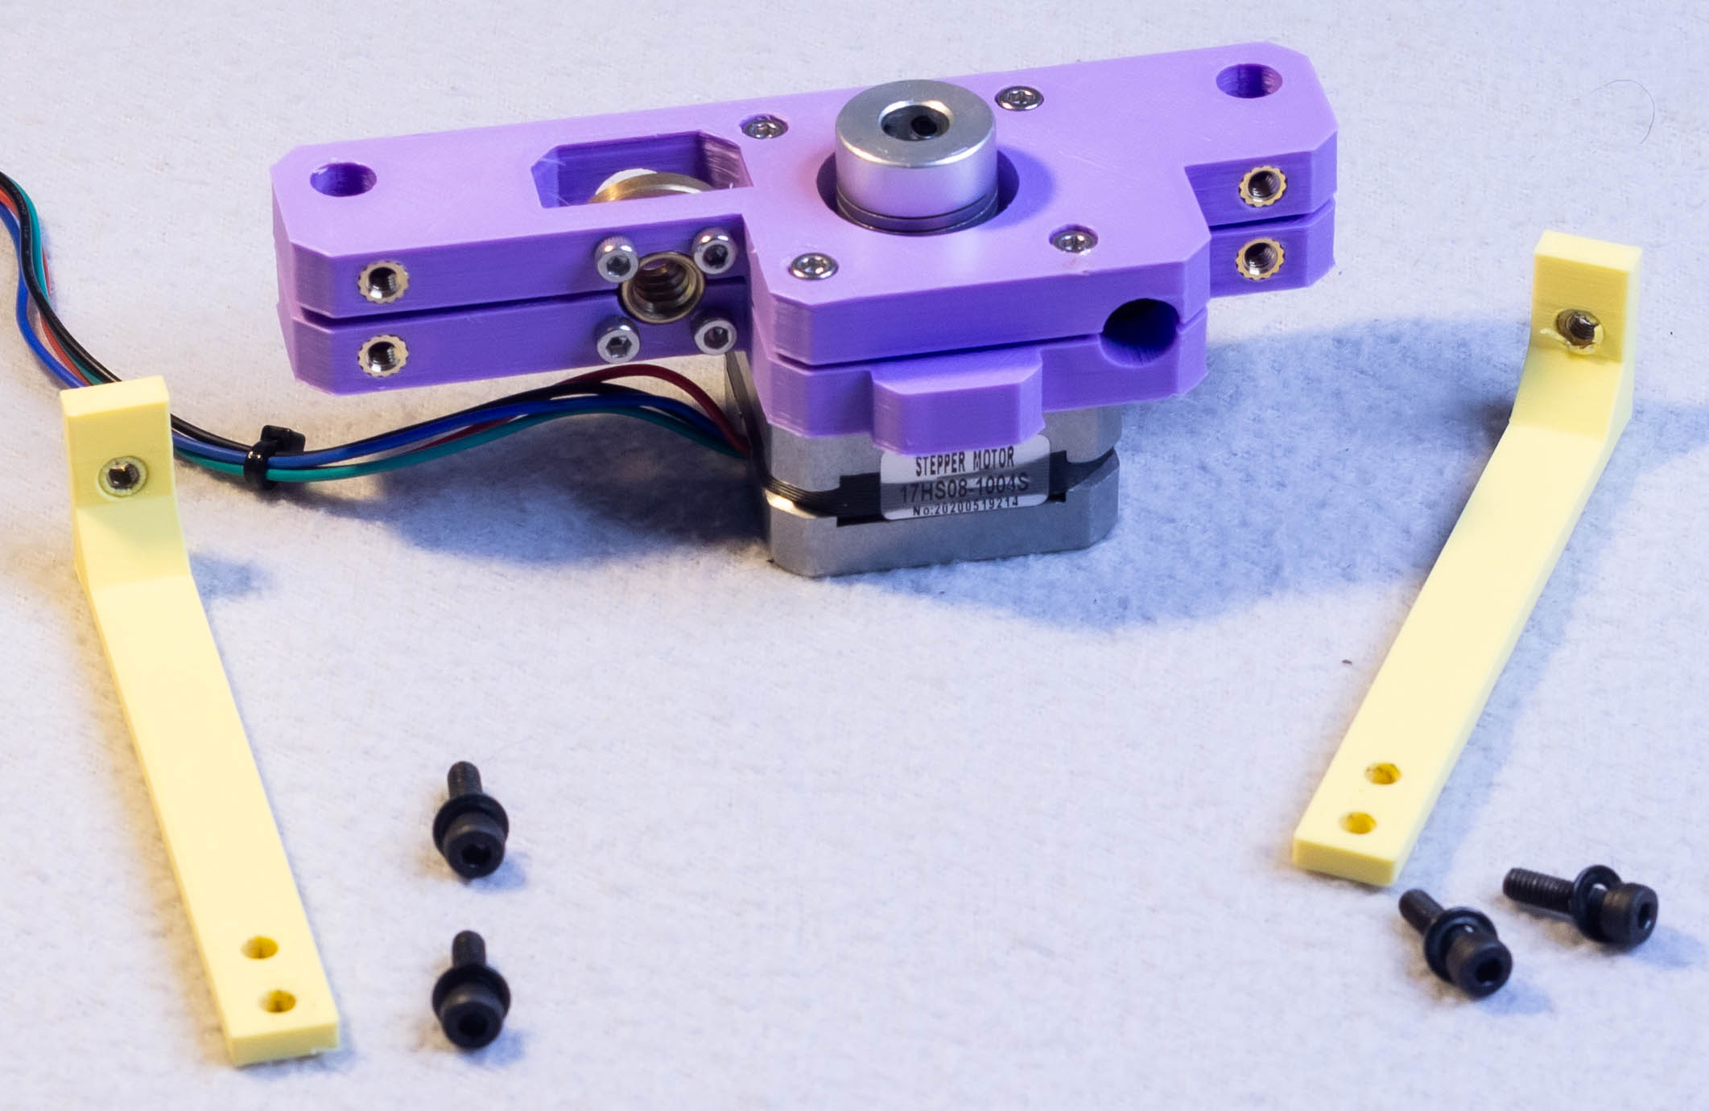
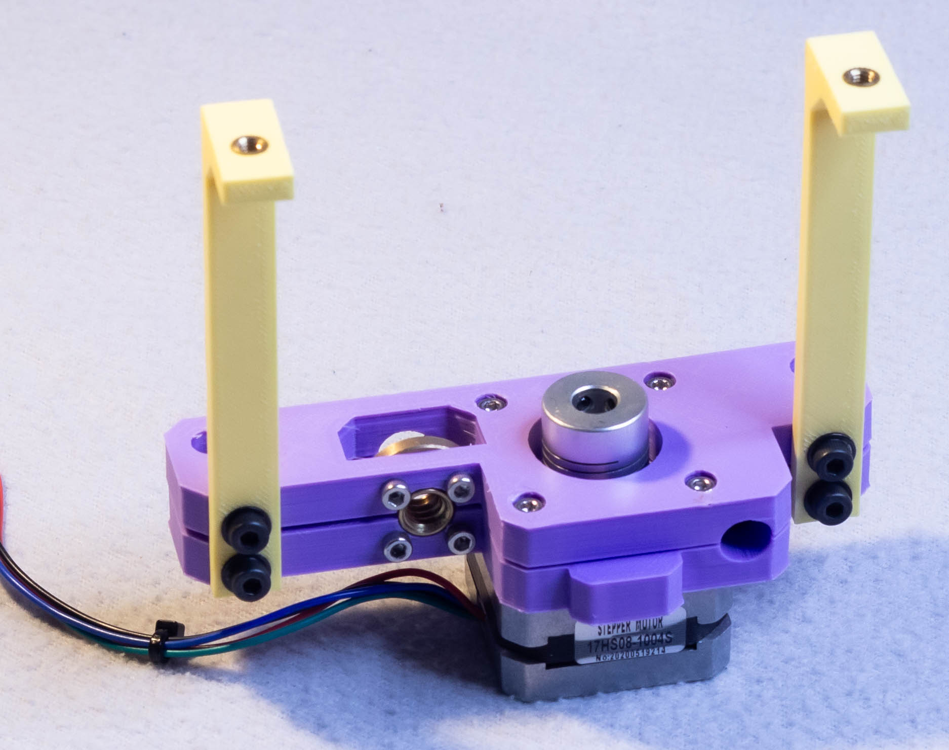
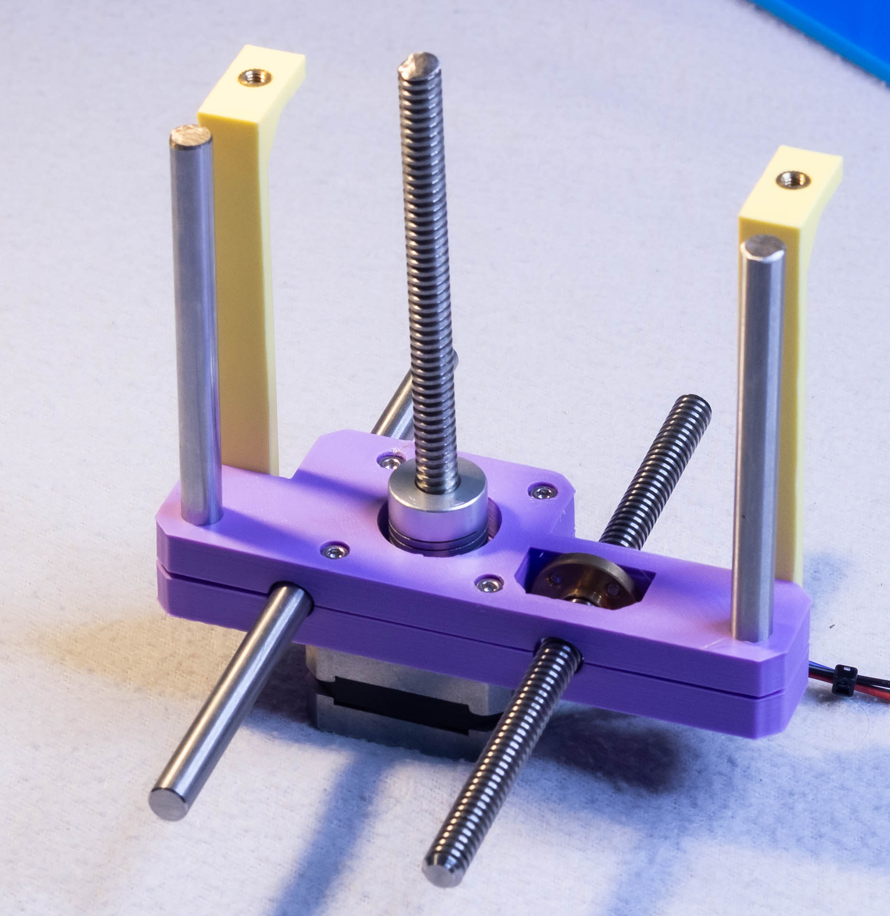
Step 3 – focus rail
Focus rail – foot x2
M4 Heat set insert x2
M4x10mm x4
8mm x 150mm rod x2 (horizontal)
T8 lead screw 150mm (horizontal)
8mm x 100mm rod x2 (vertical)
T8 lead screw 100mm (vertical)

Slide 5
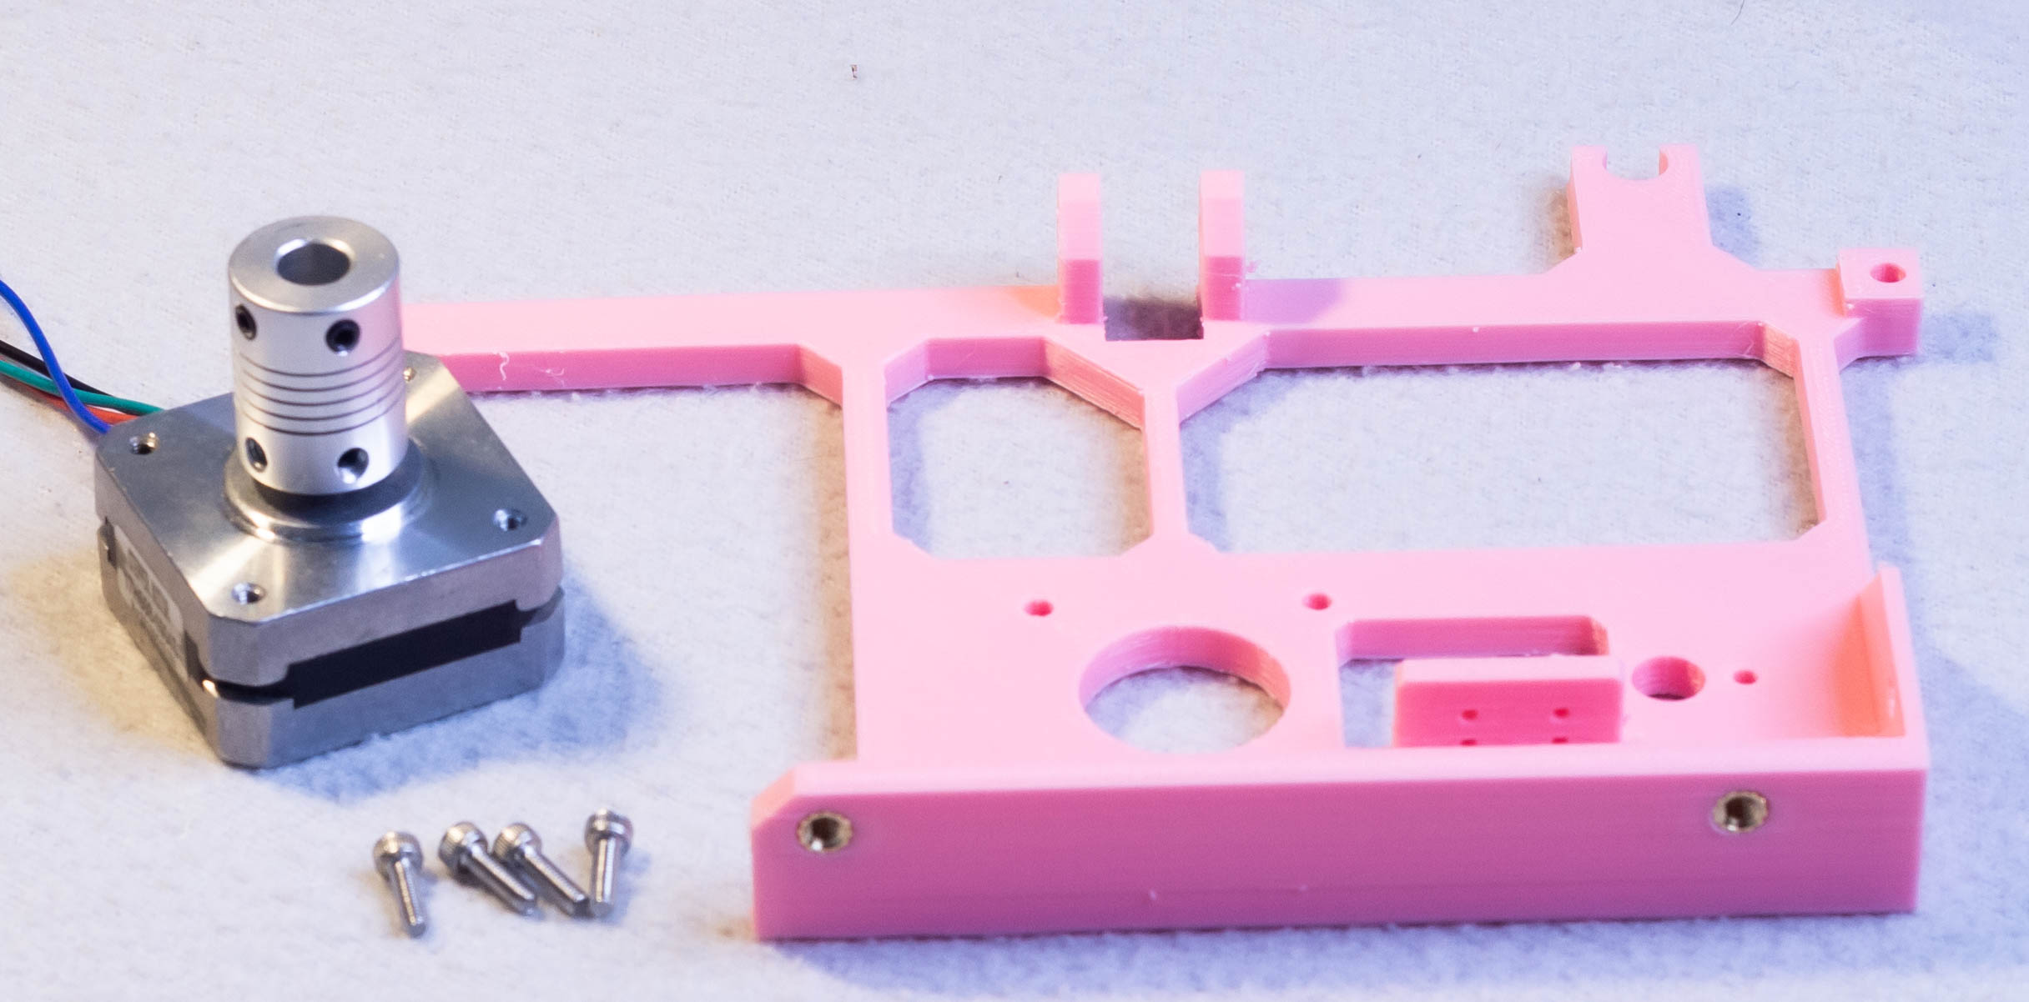
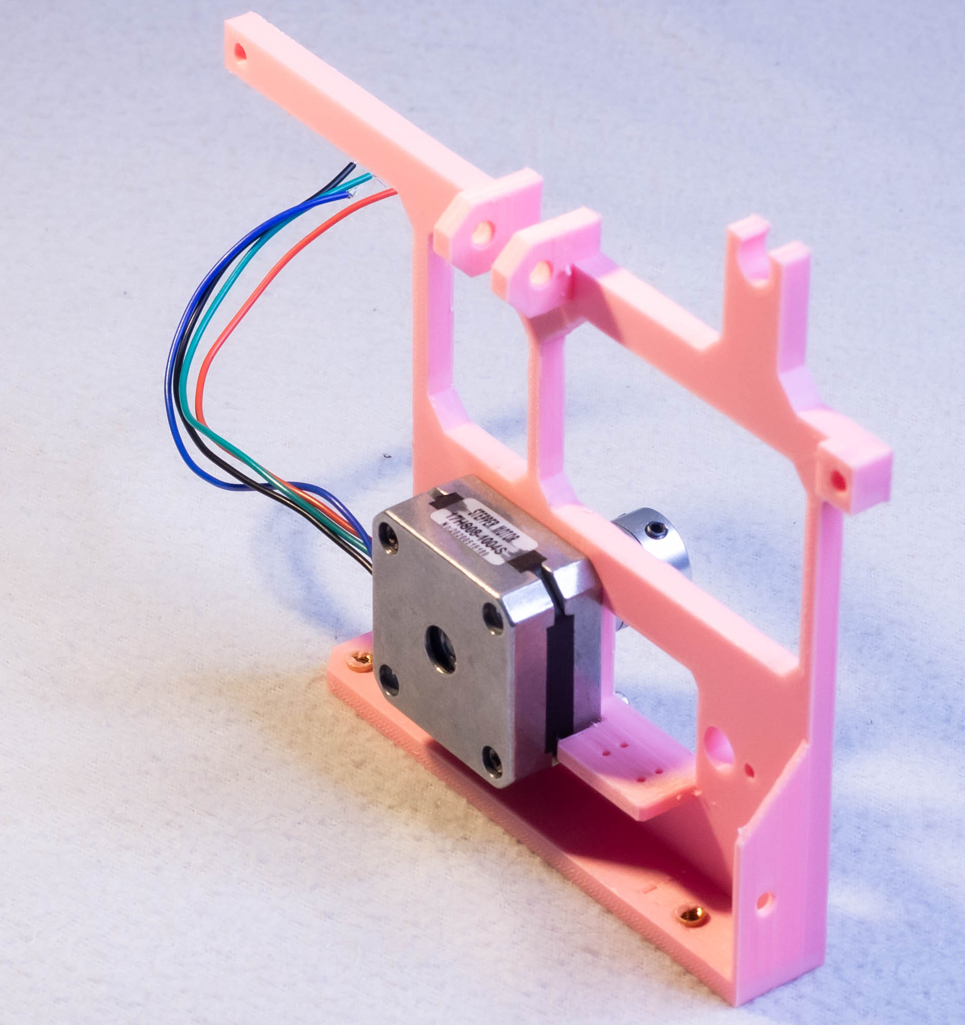
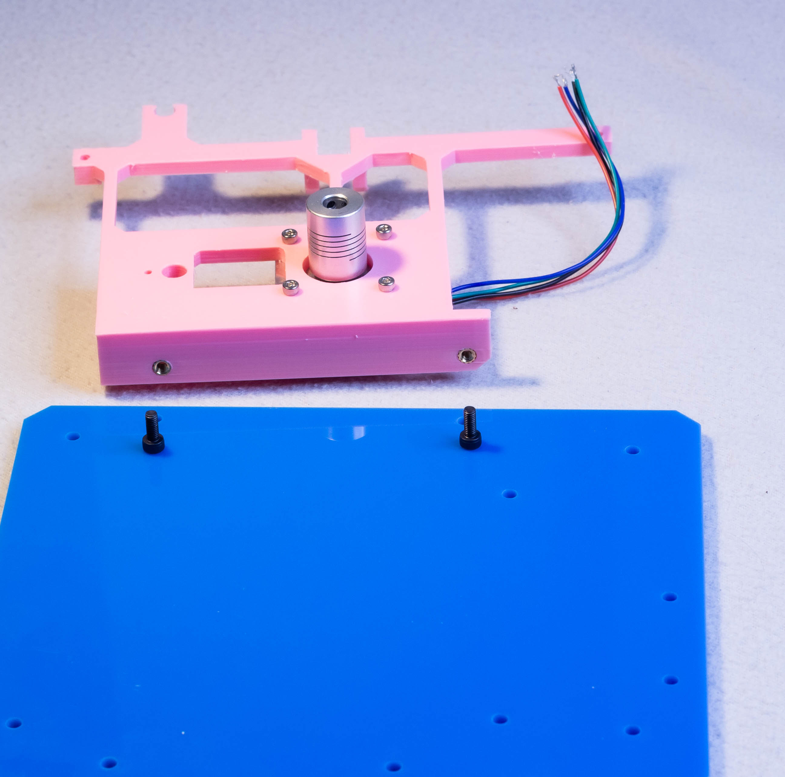
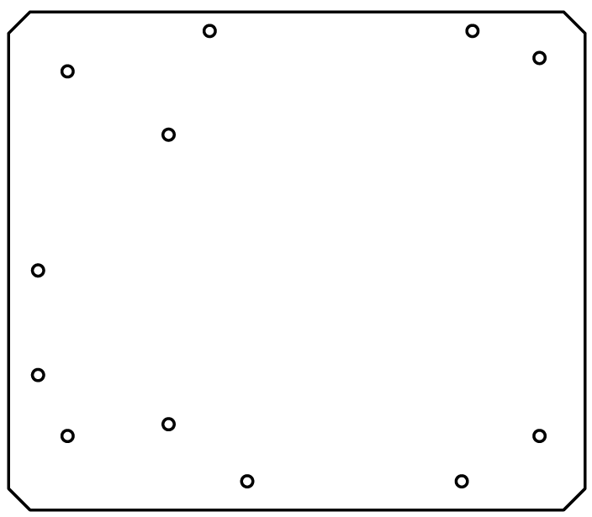
Step 4 – X motor plate
Focus rail – foot x2
M4 Heat set insert x2
M4x10mm x4

Slide 6
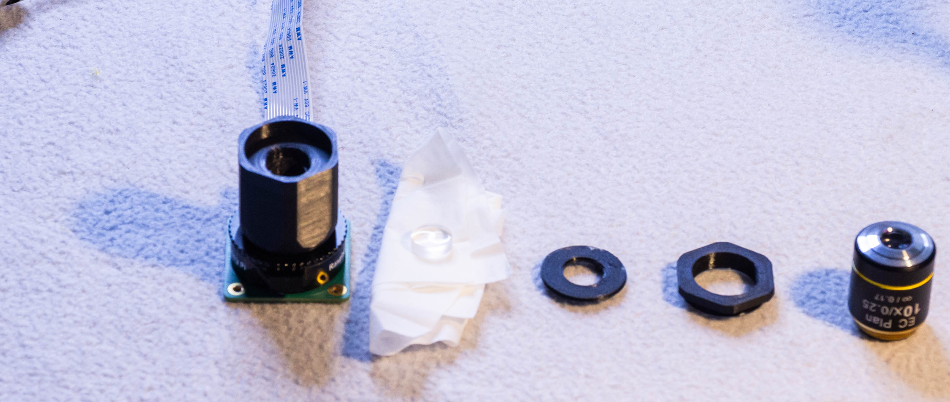
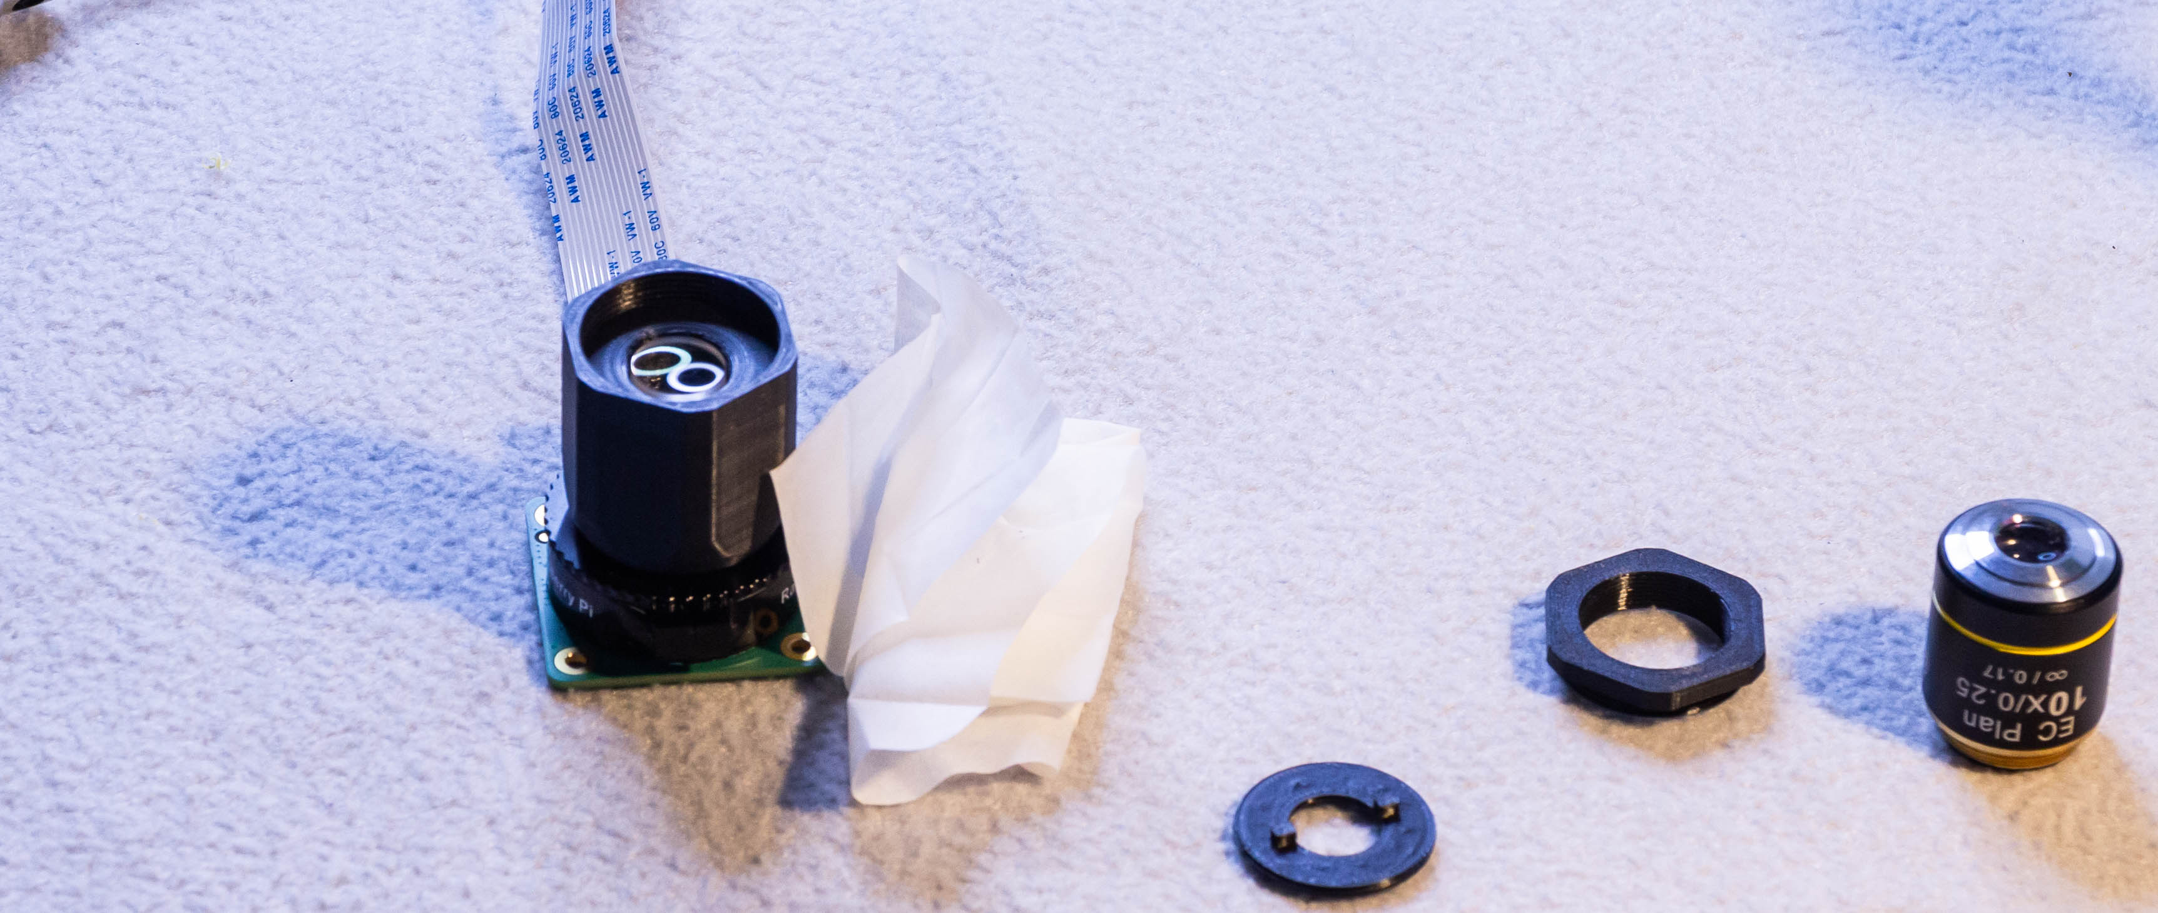
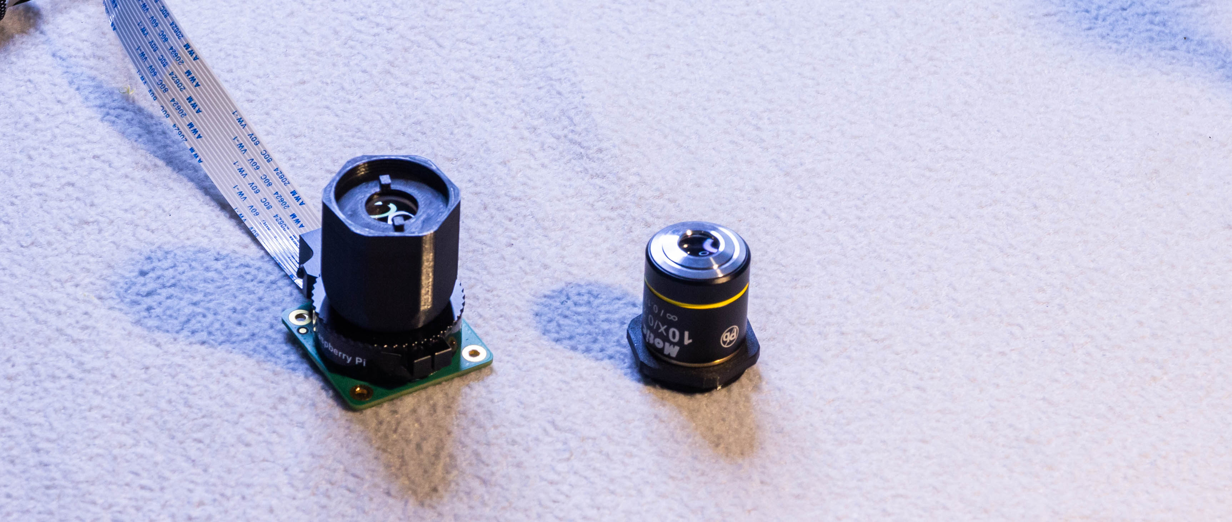
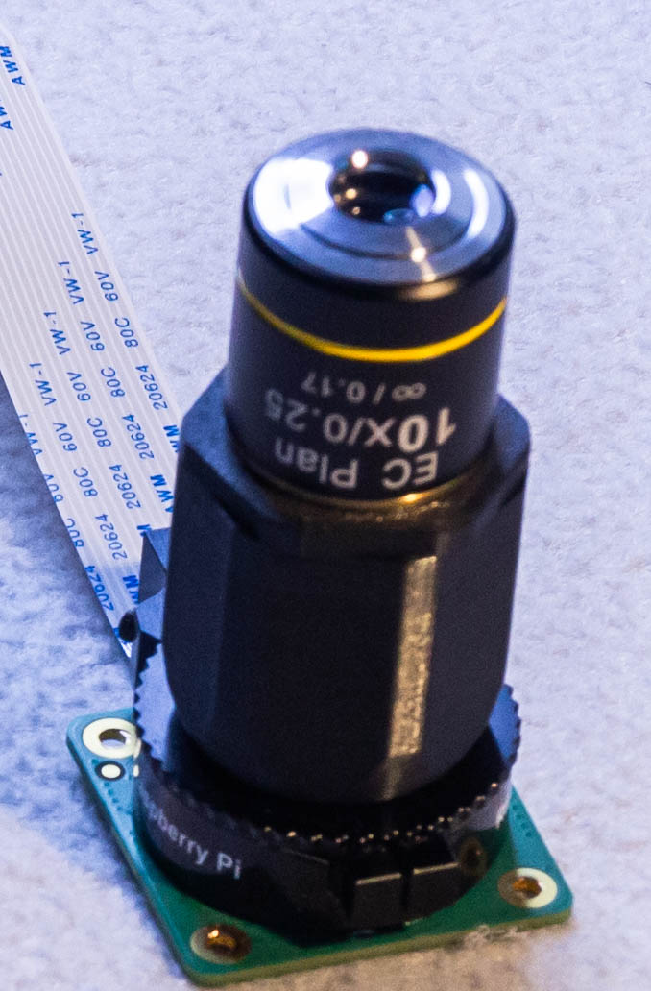
Step 5 – optics

Slide 7
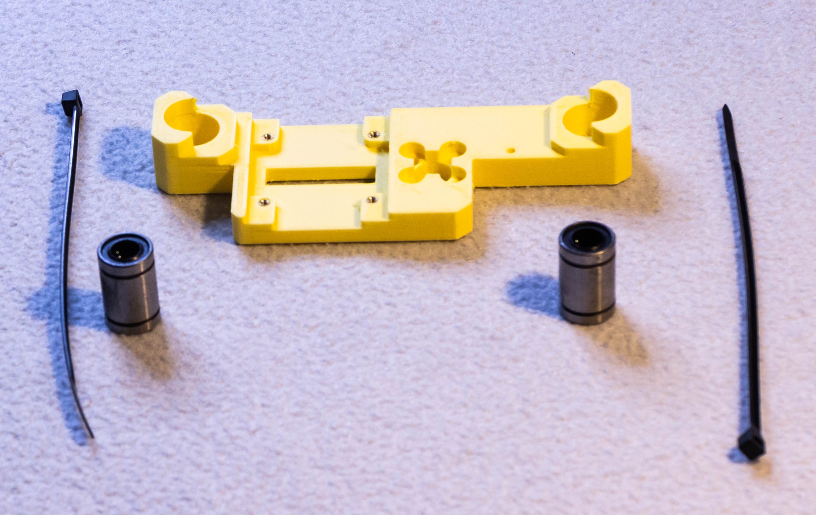
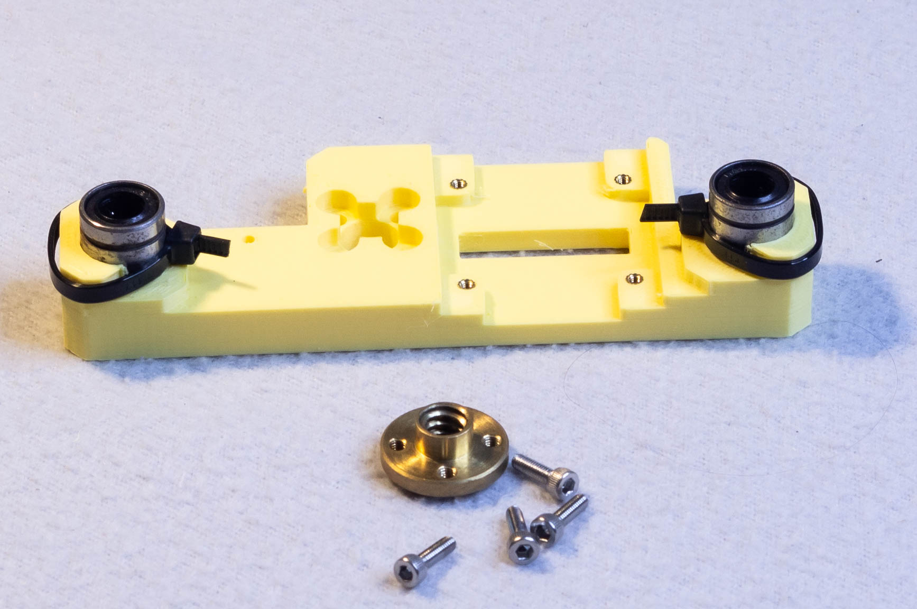
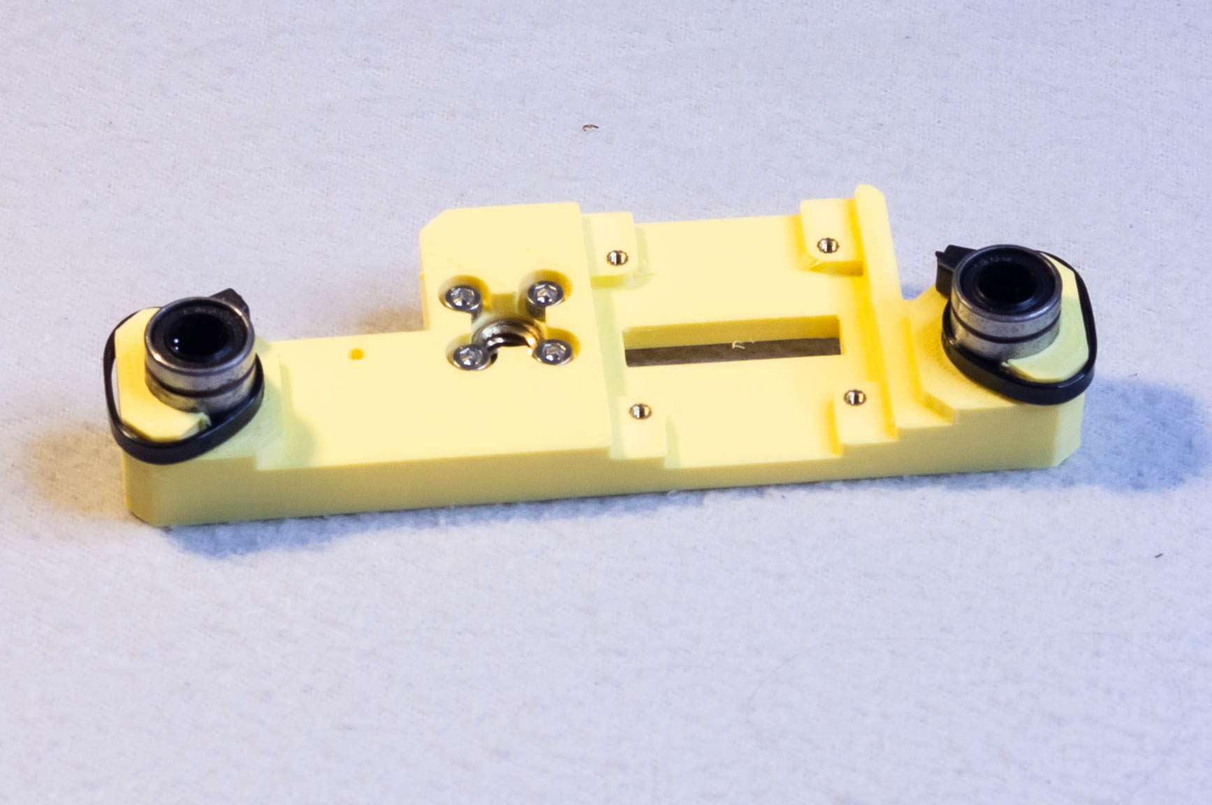
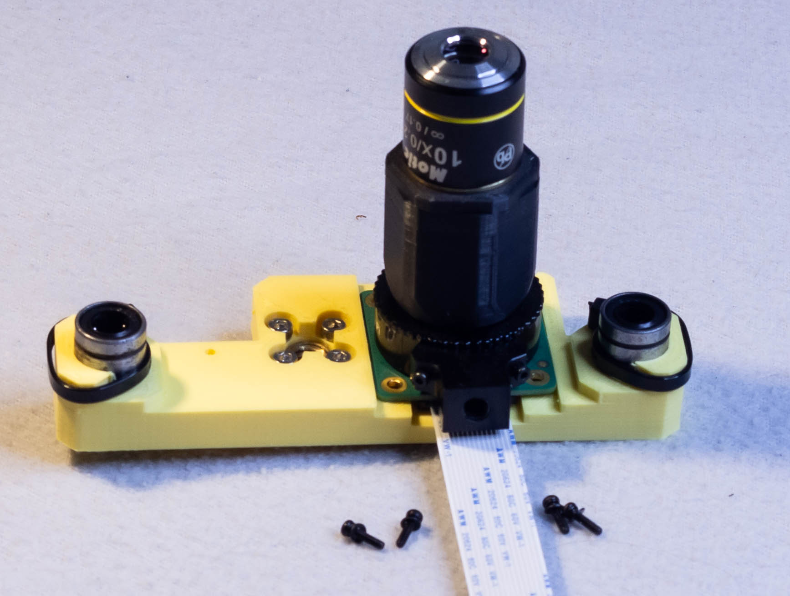
Step 6 – optic holder
Focus rail – foot x2
M4 Heat set insert x2
M4x10mm x4

Slide 8
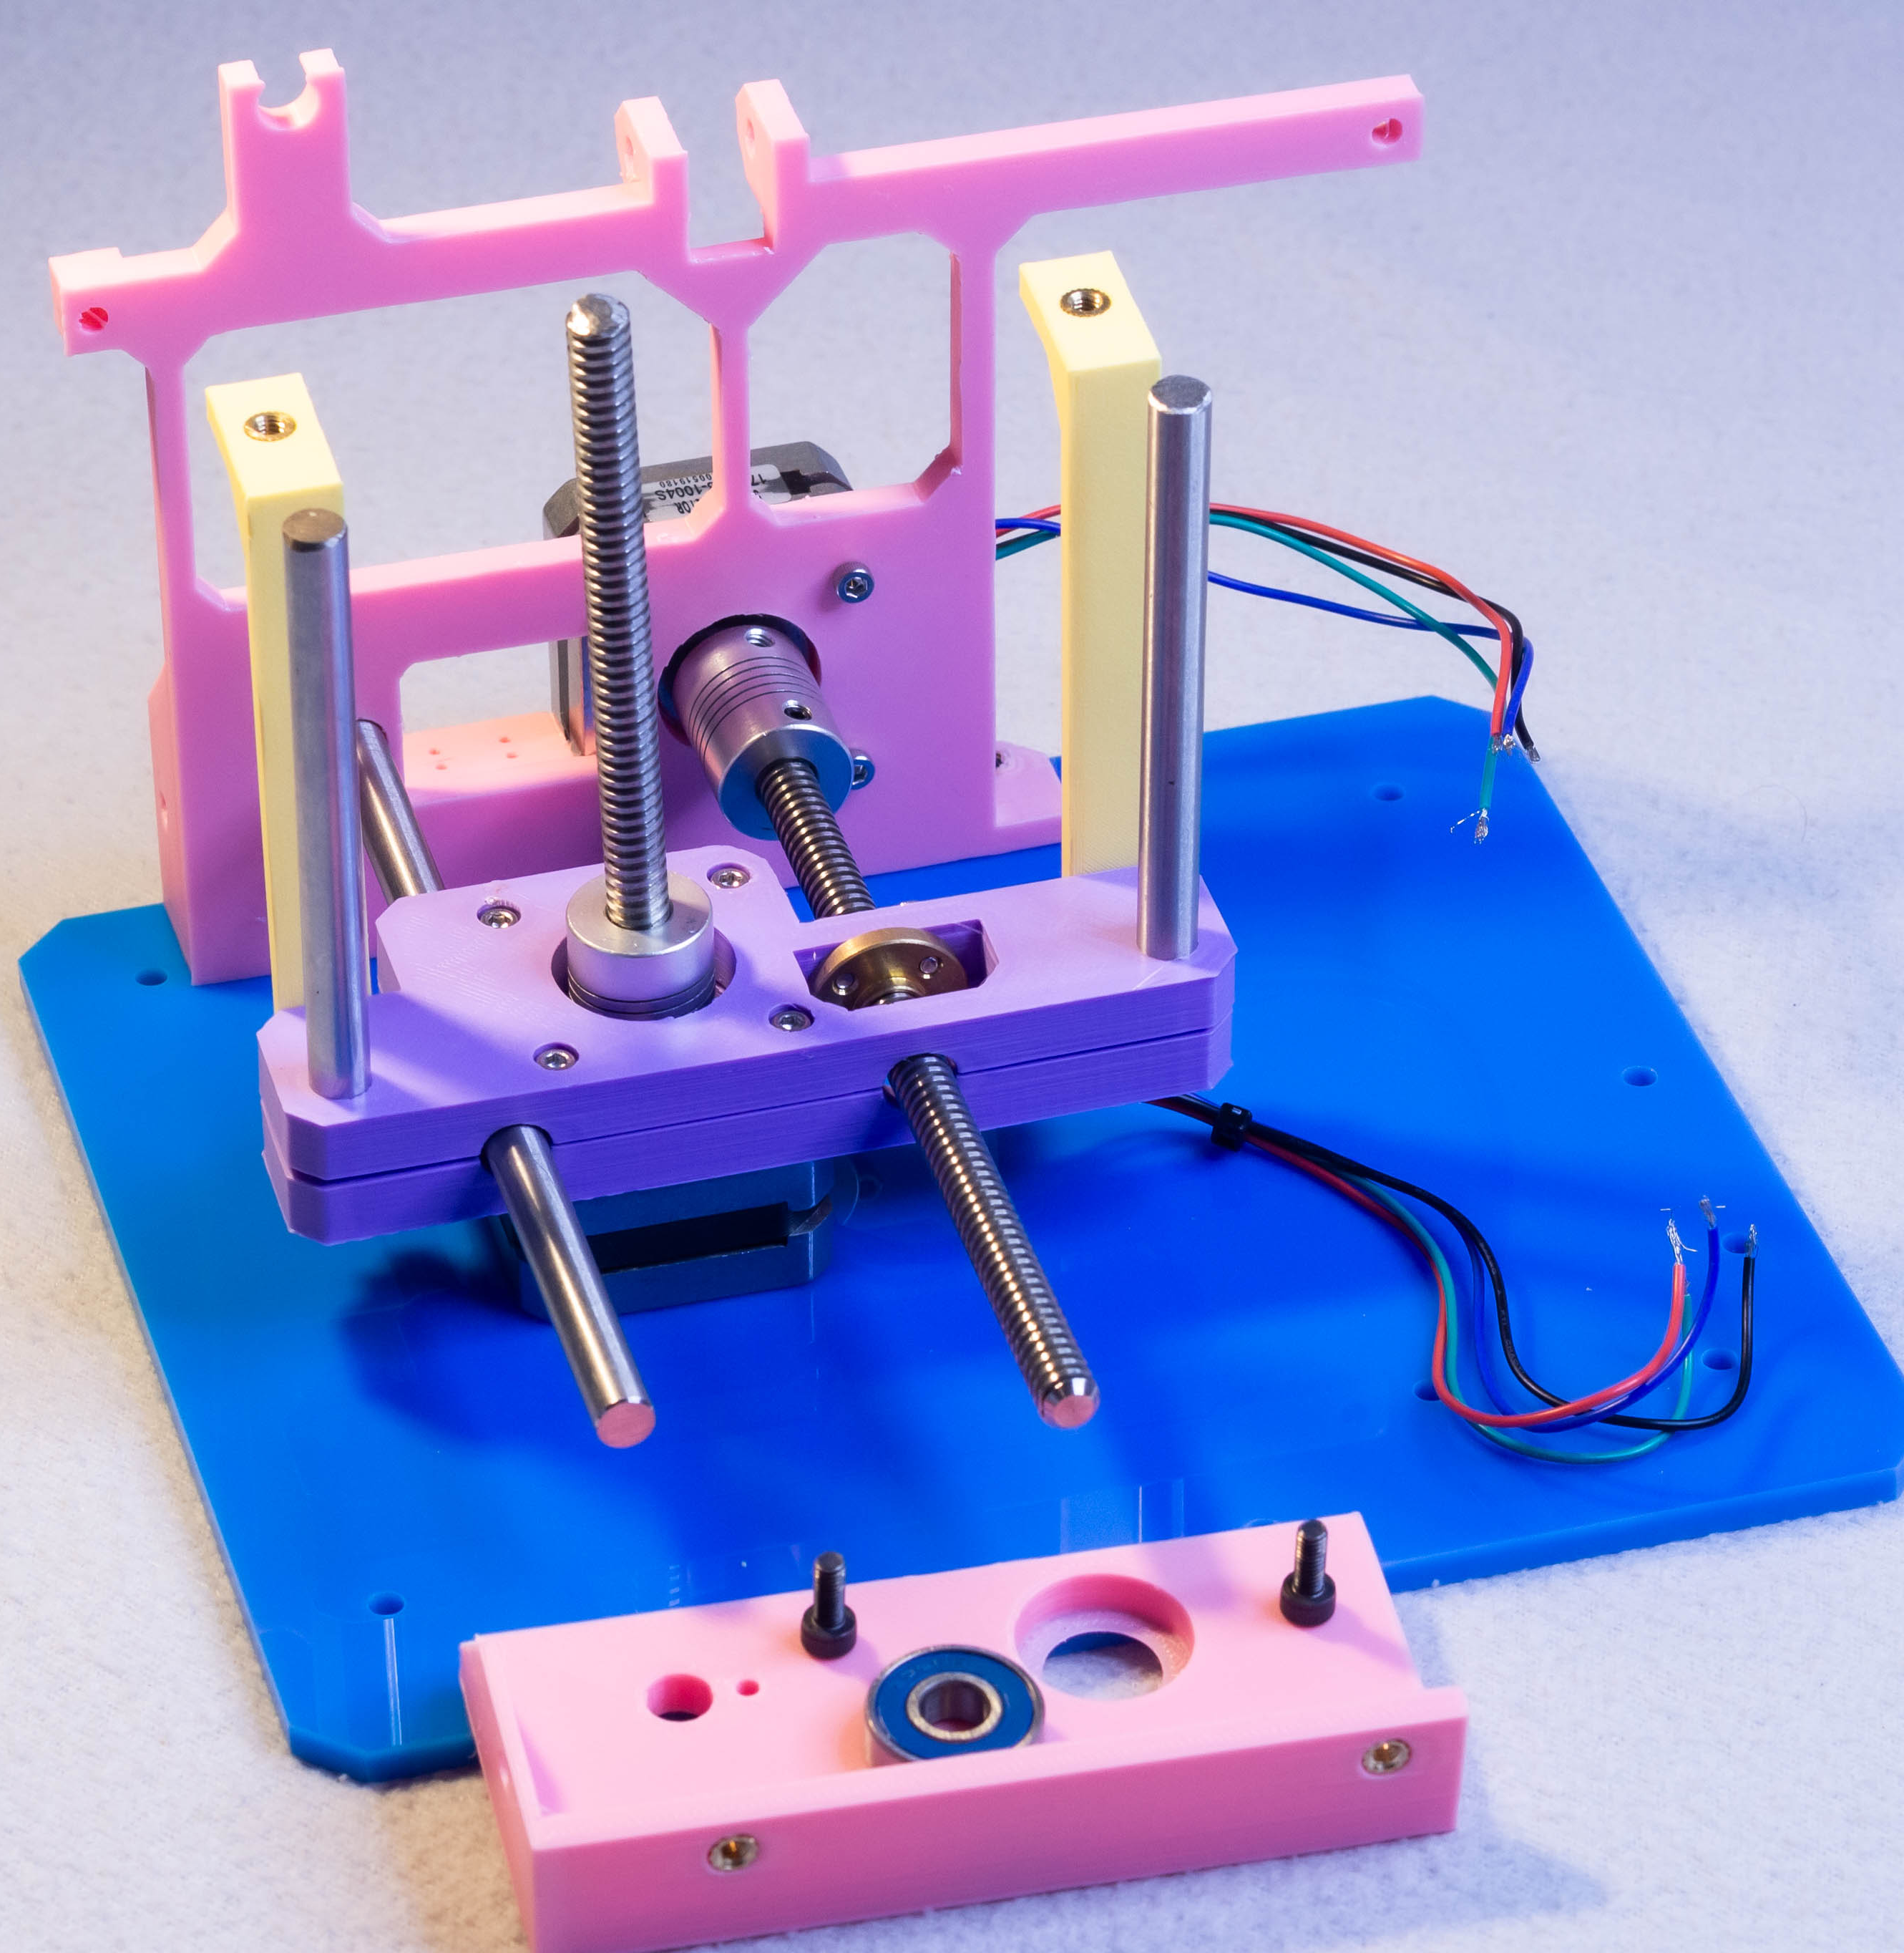
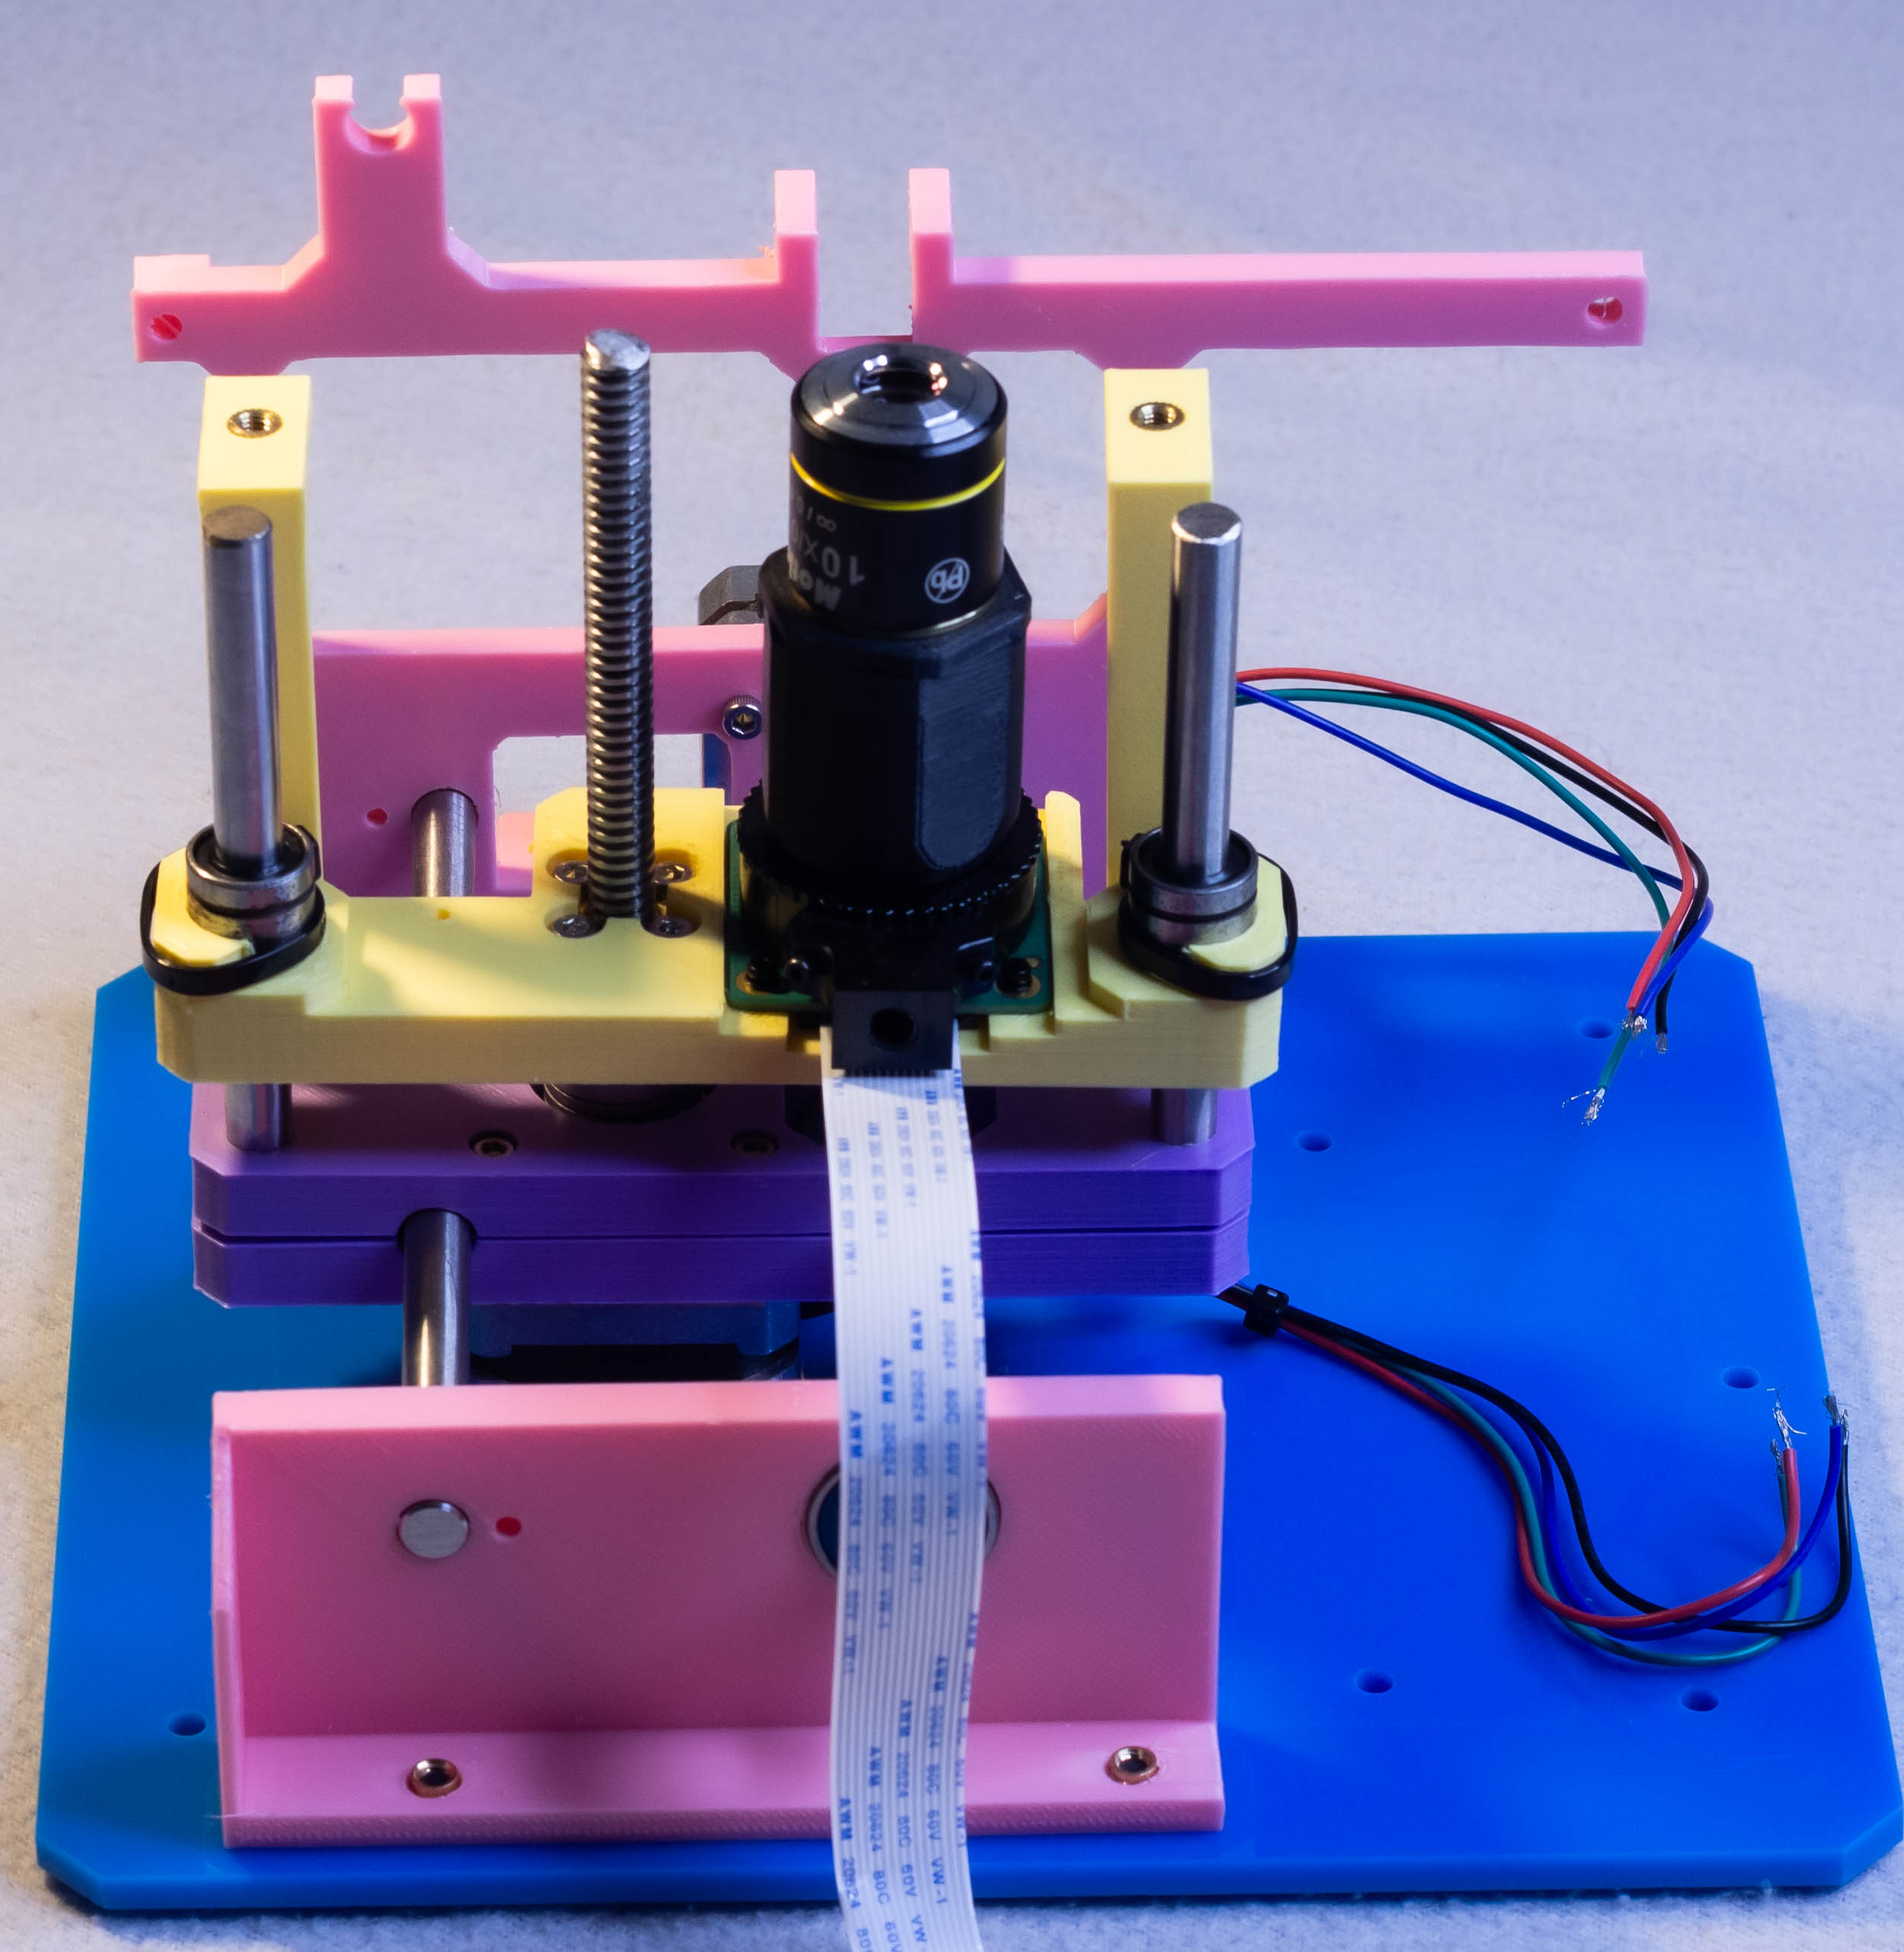
Step 7 – optic holder
Focus rail – foot x2
M4 Heat set insert x2
M4x10mm x4

Slide 9
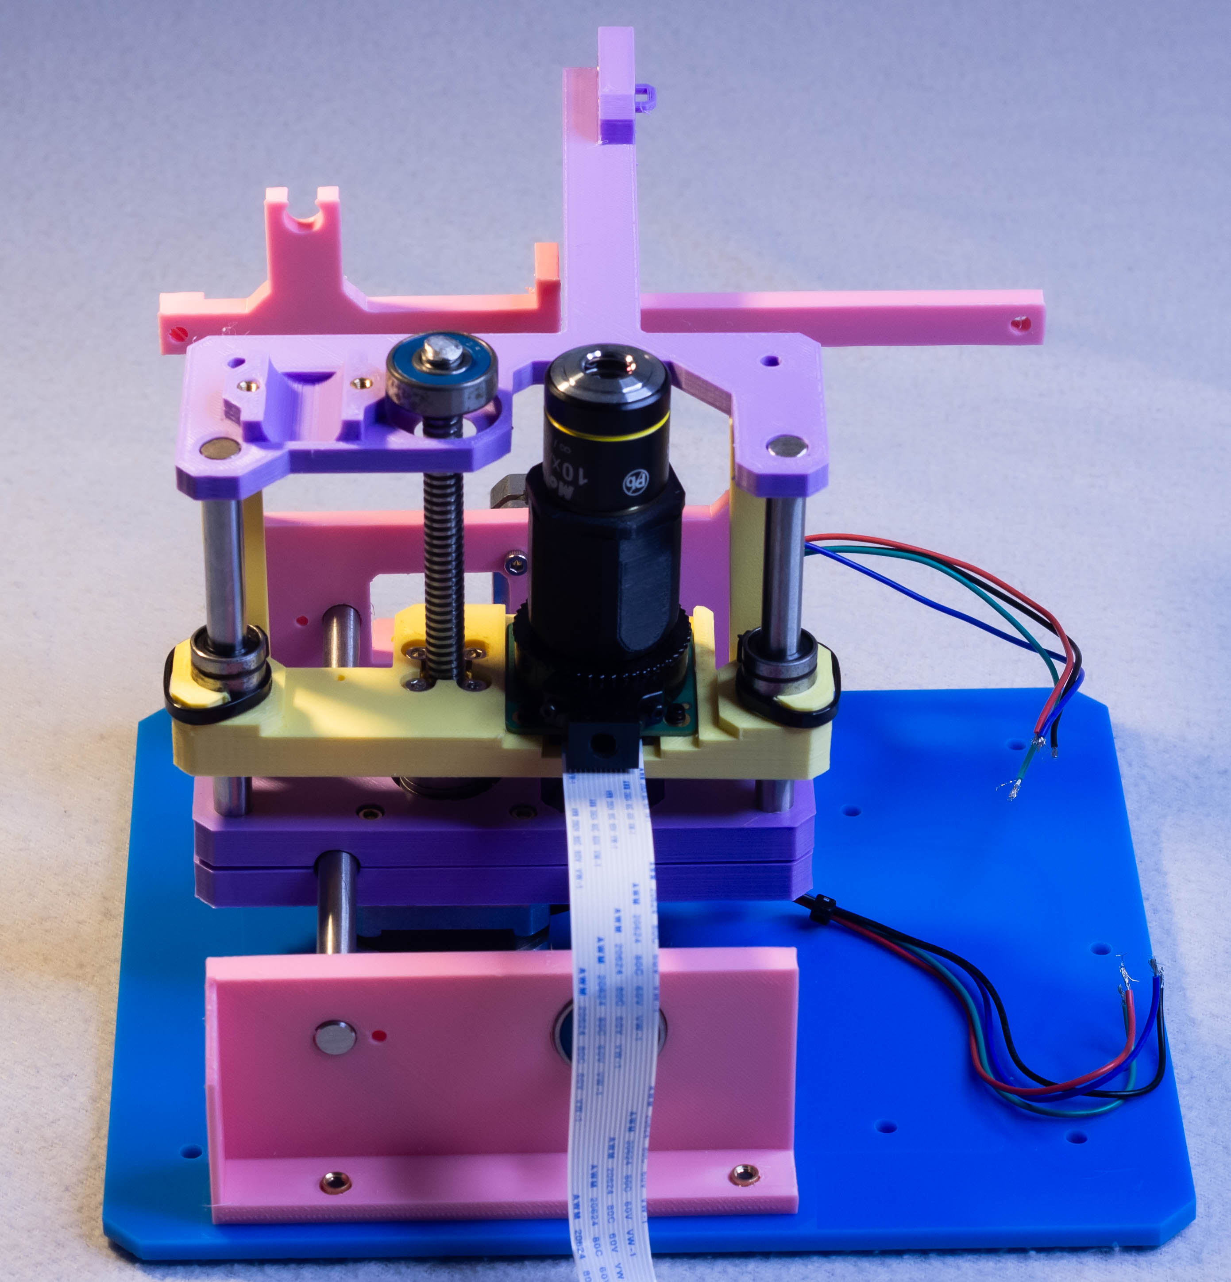
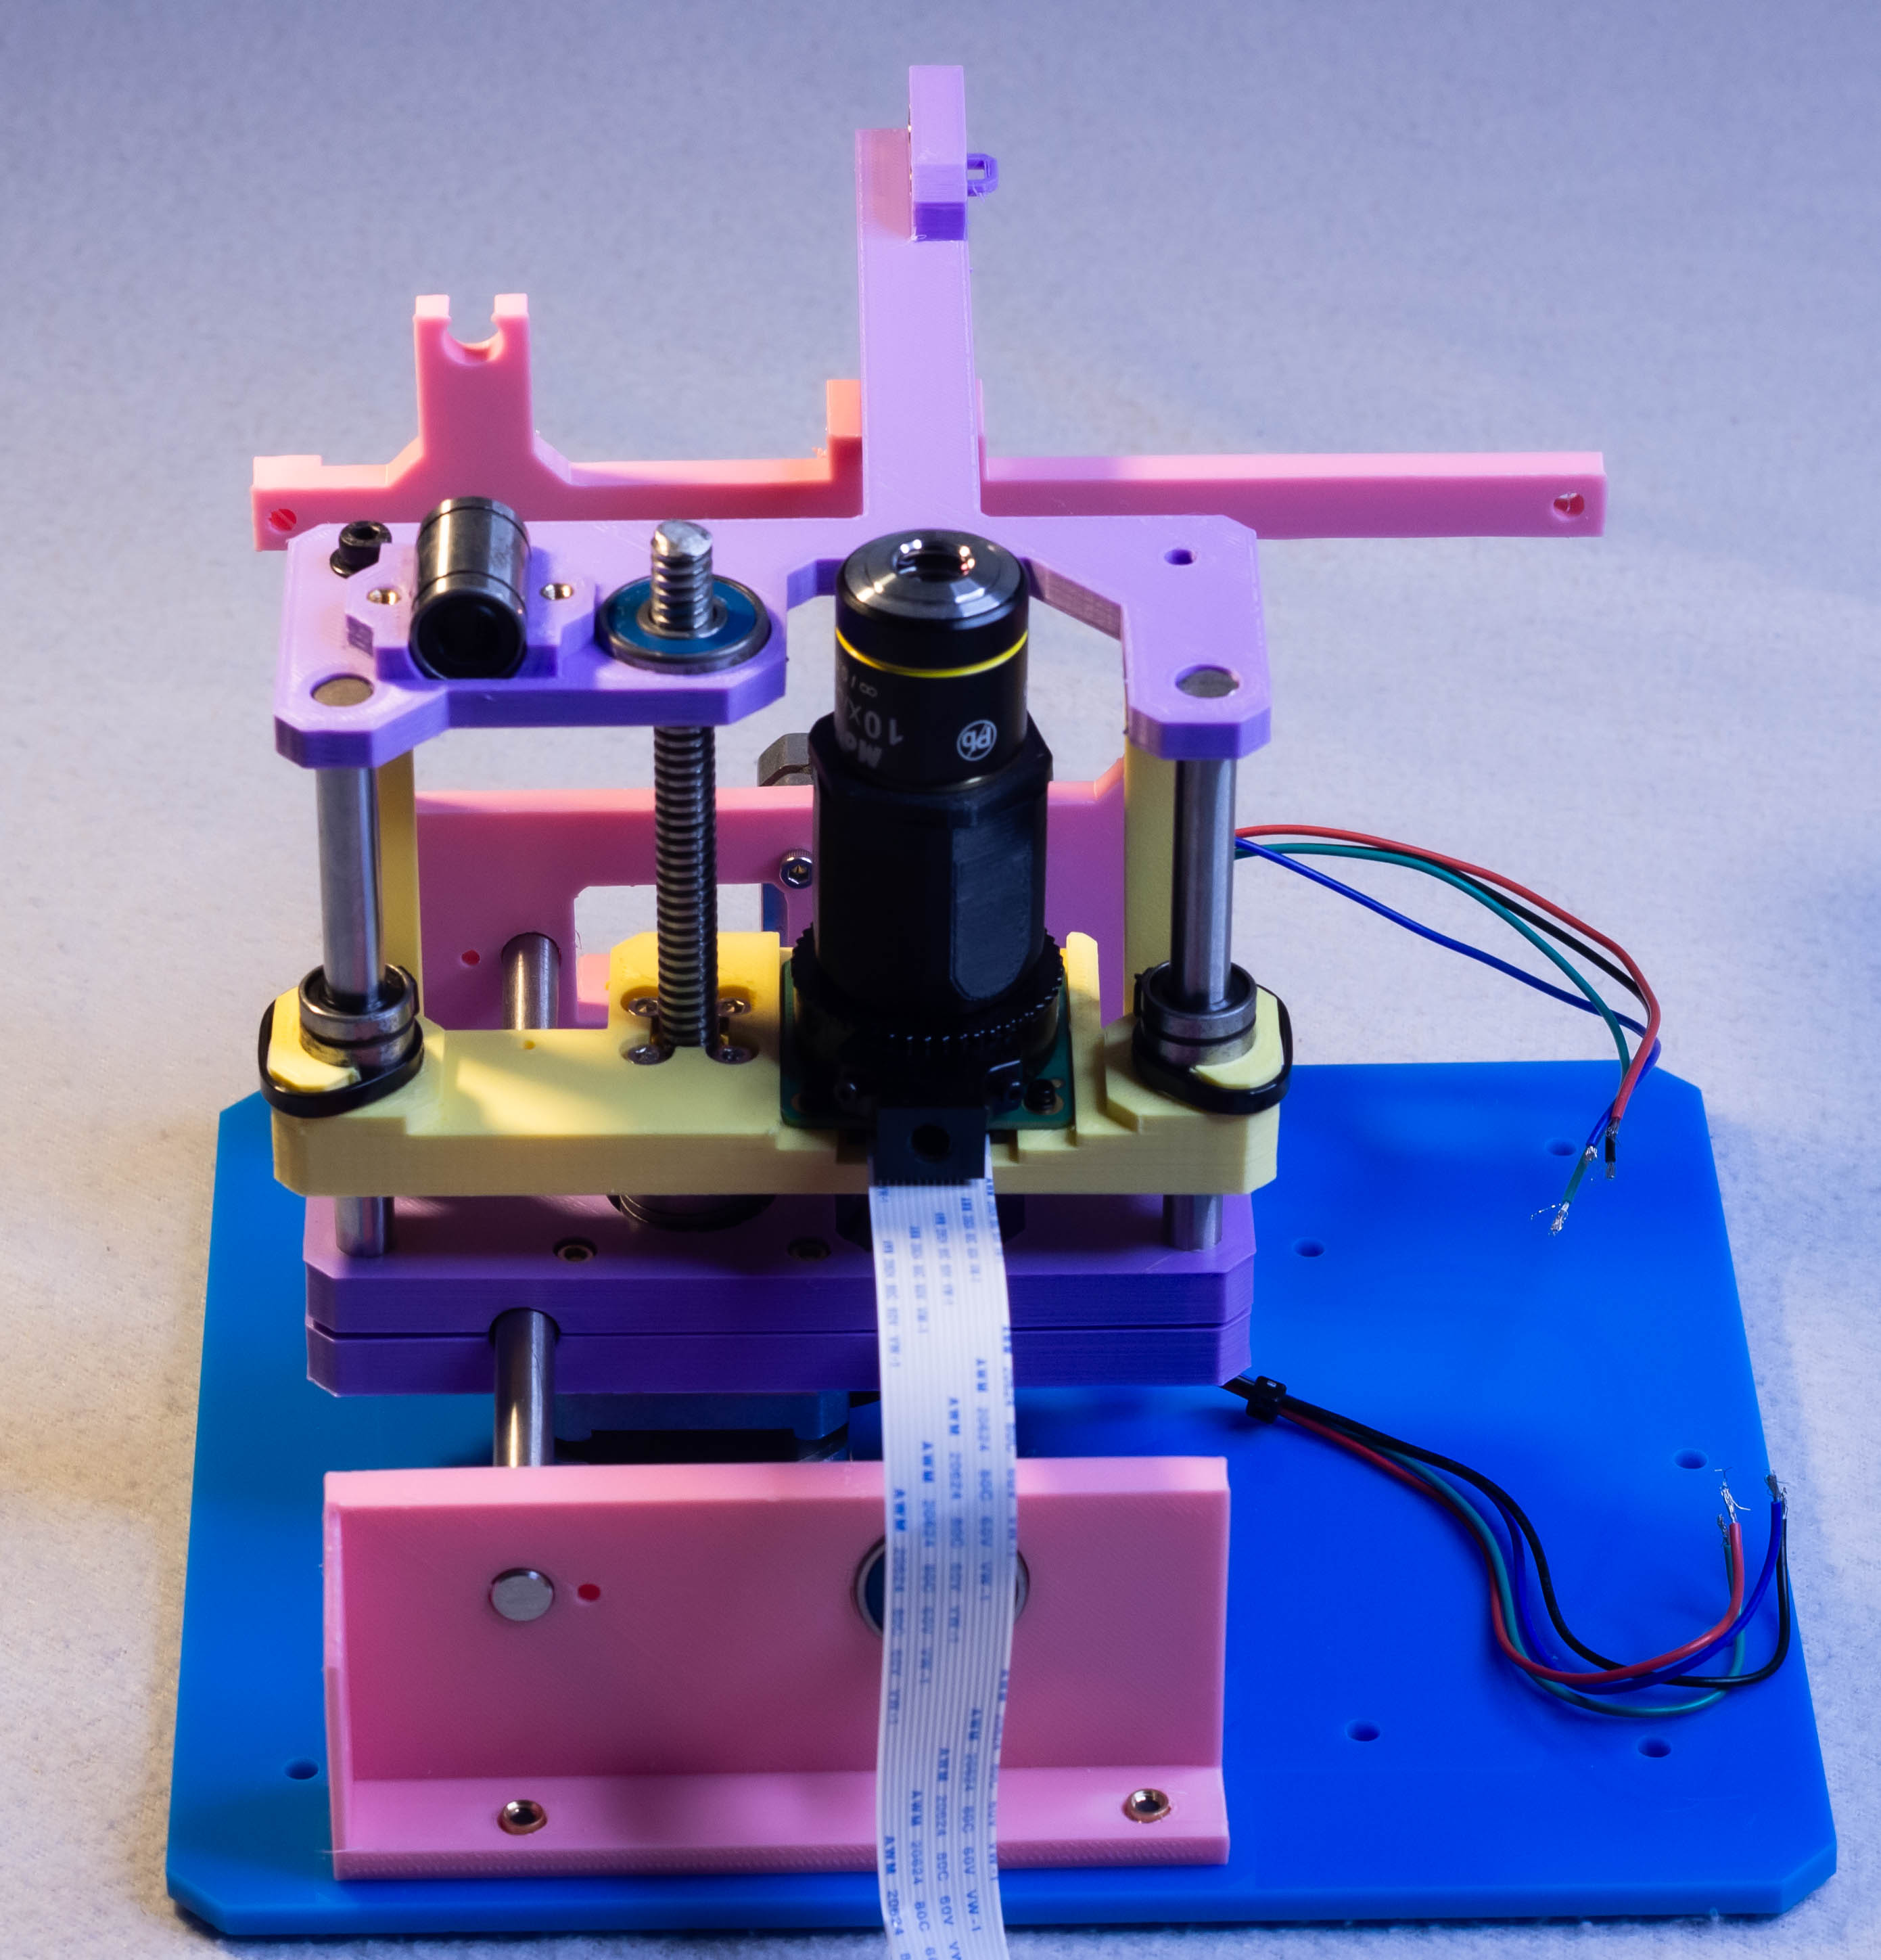
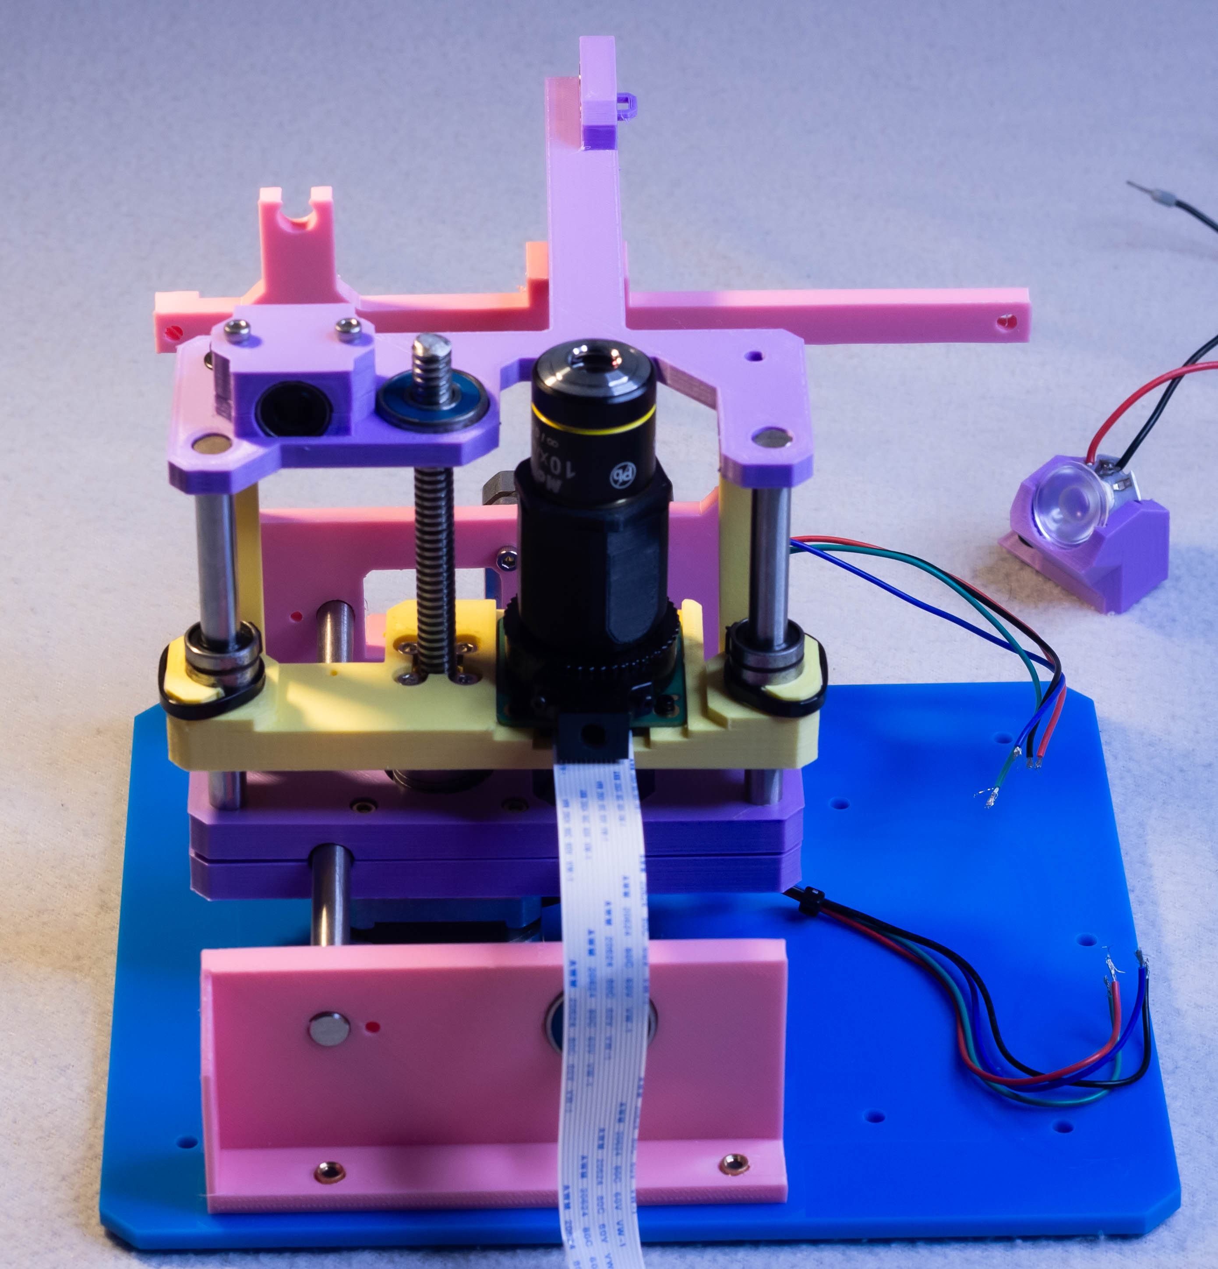
Step 7 – optic holder
Focus rail – foot x2
M4 Heat set insert x2
M4x10mm x4

Slide 10
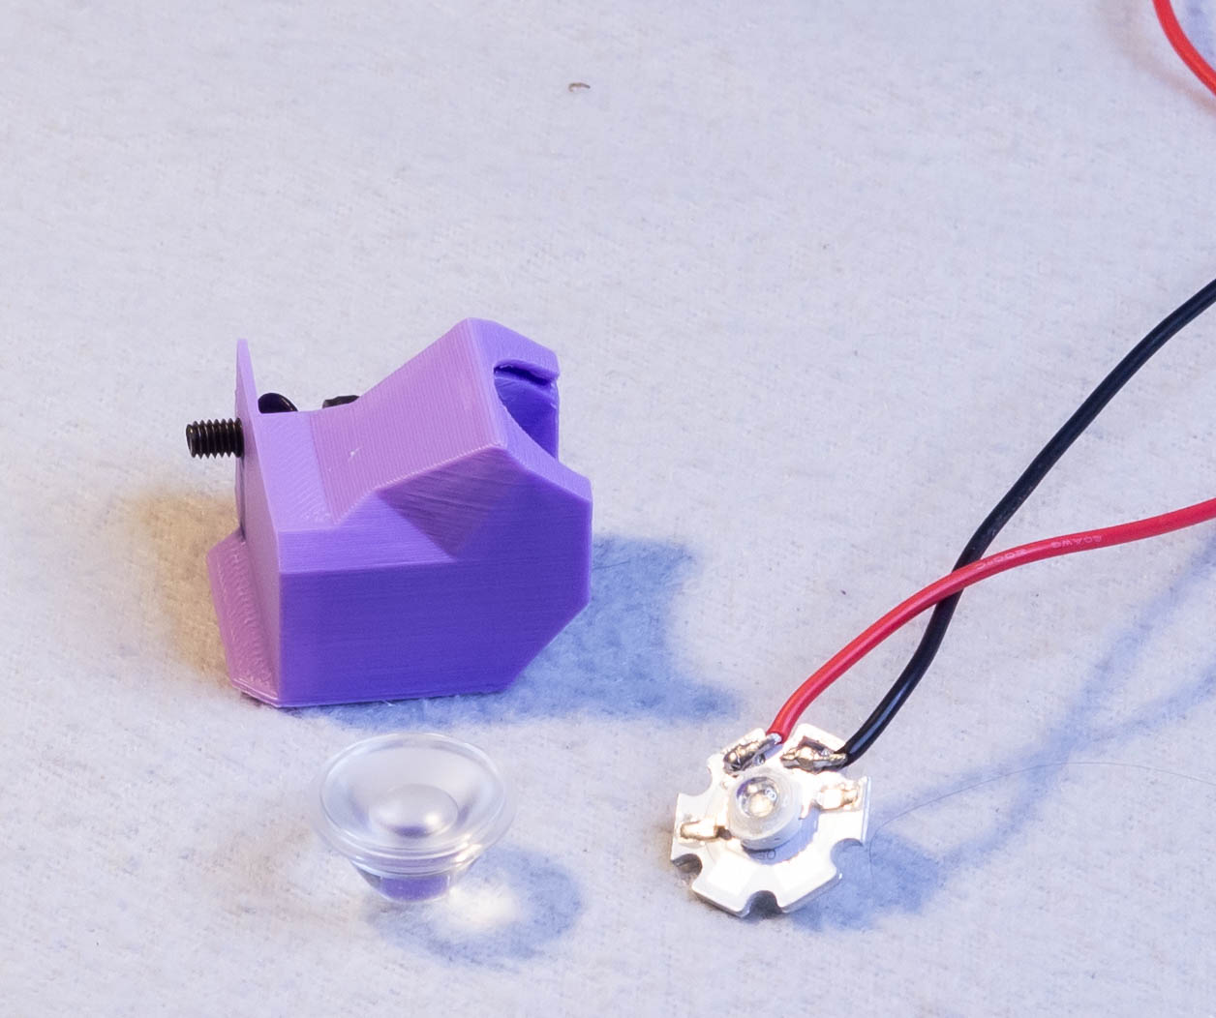
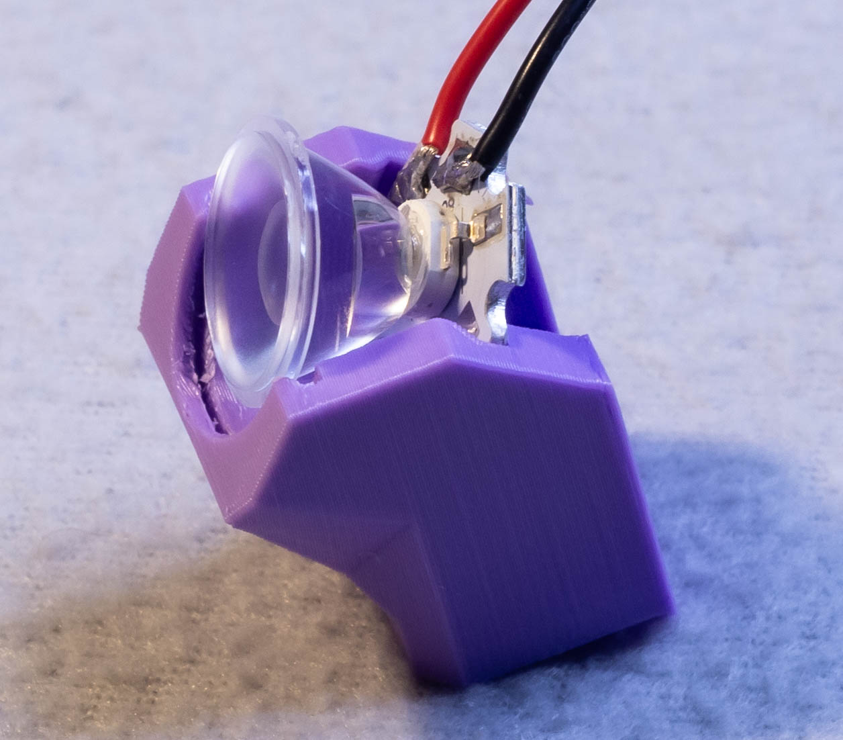
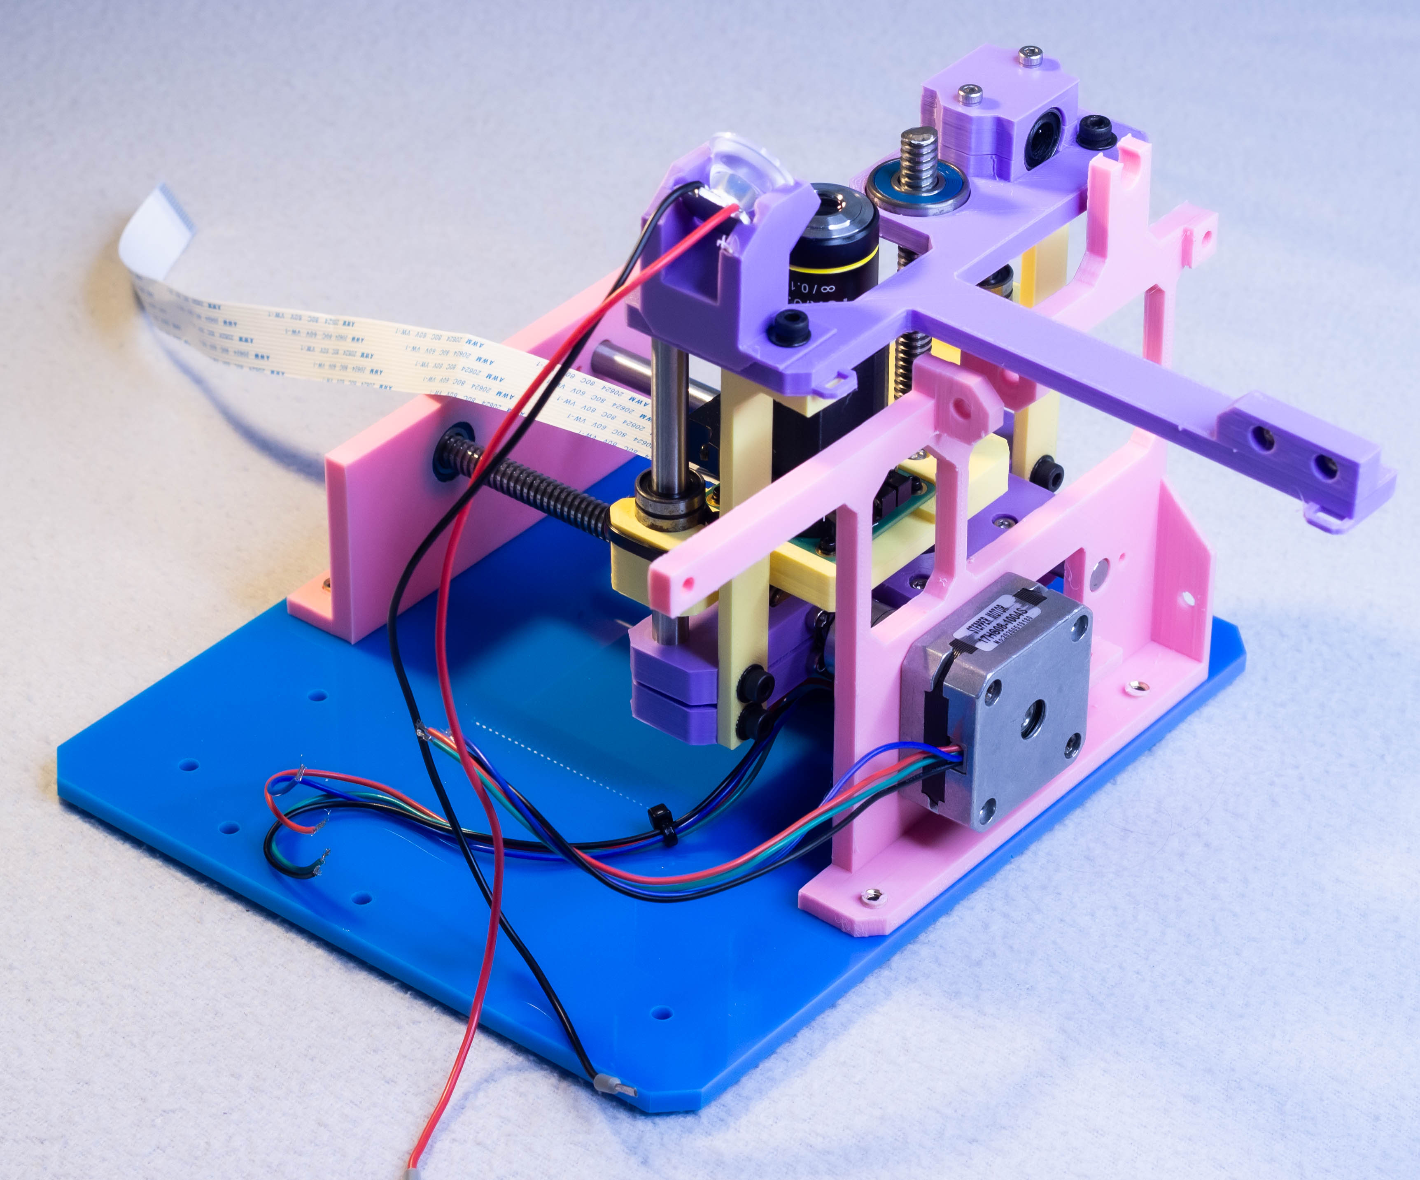
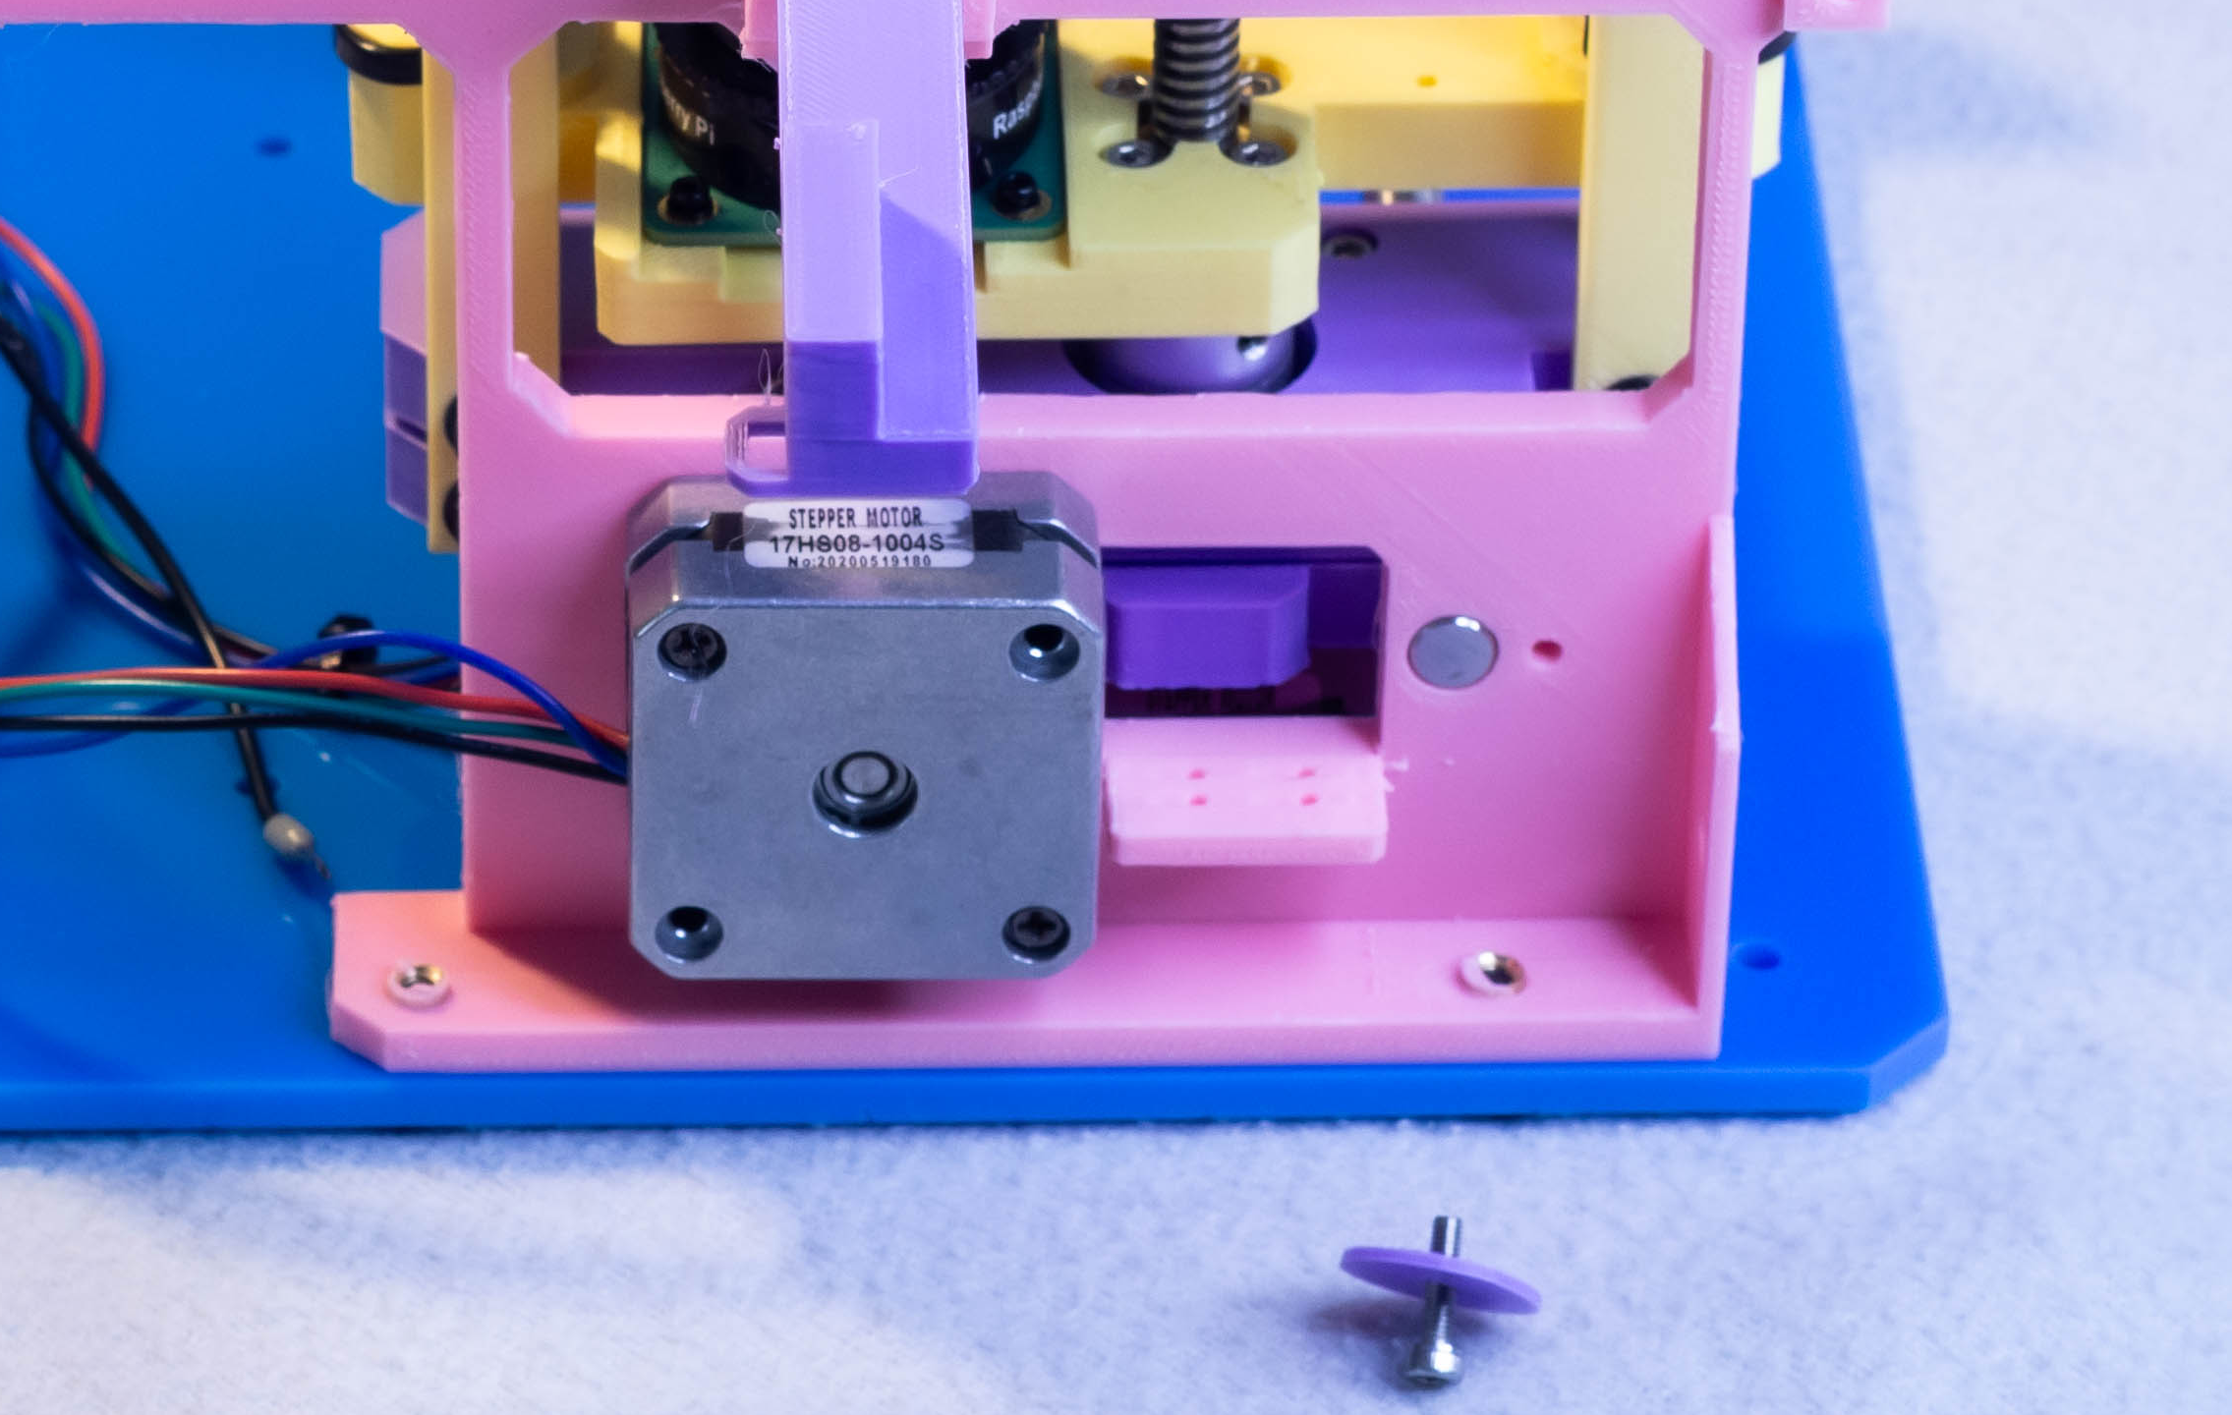
Step 7 – optic holder
Focus rail – foot x2
M4 Heat set insert x2
M4x10mm x4

Slide 11
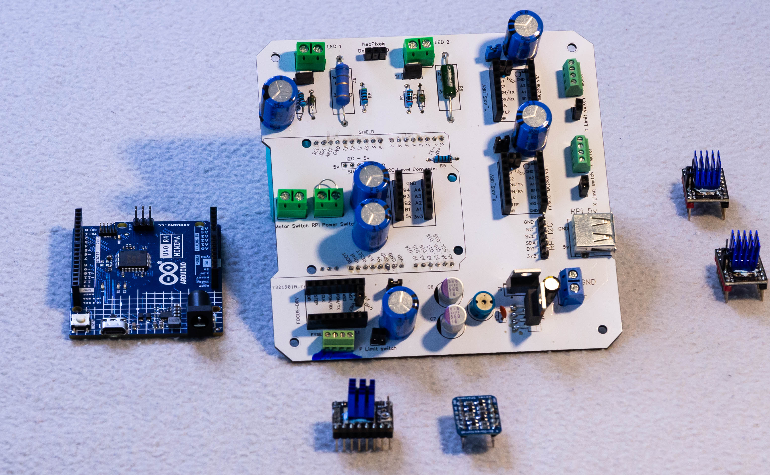
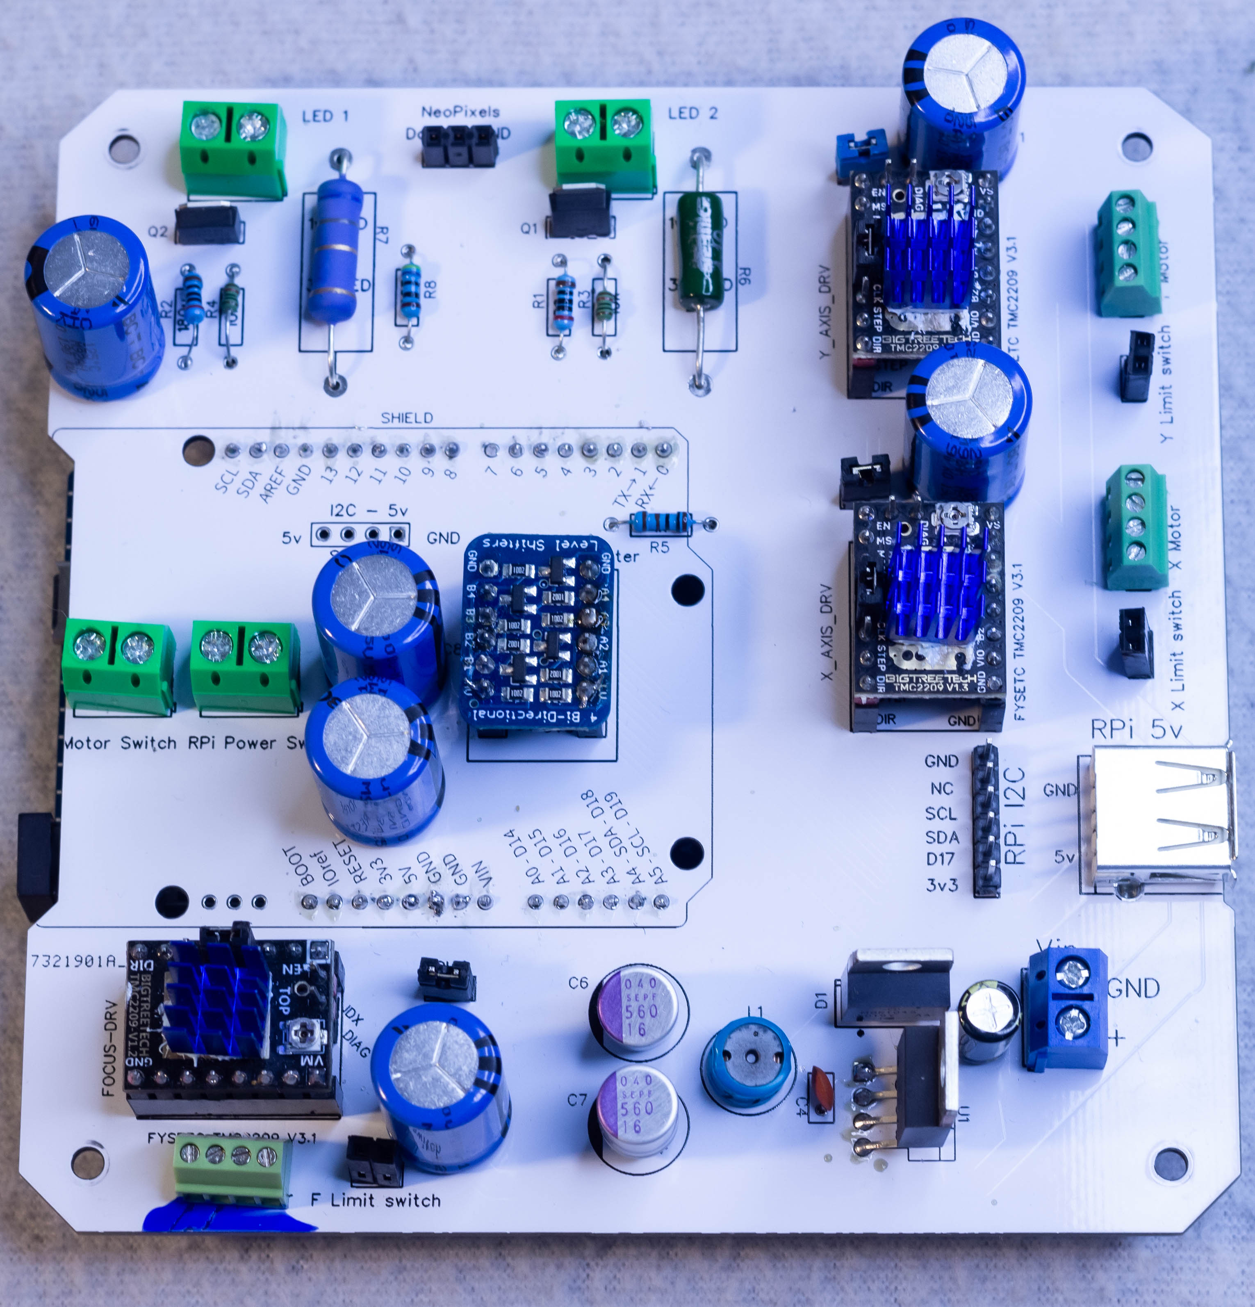
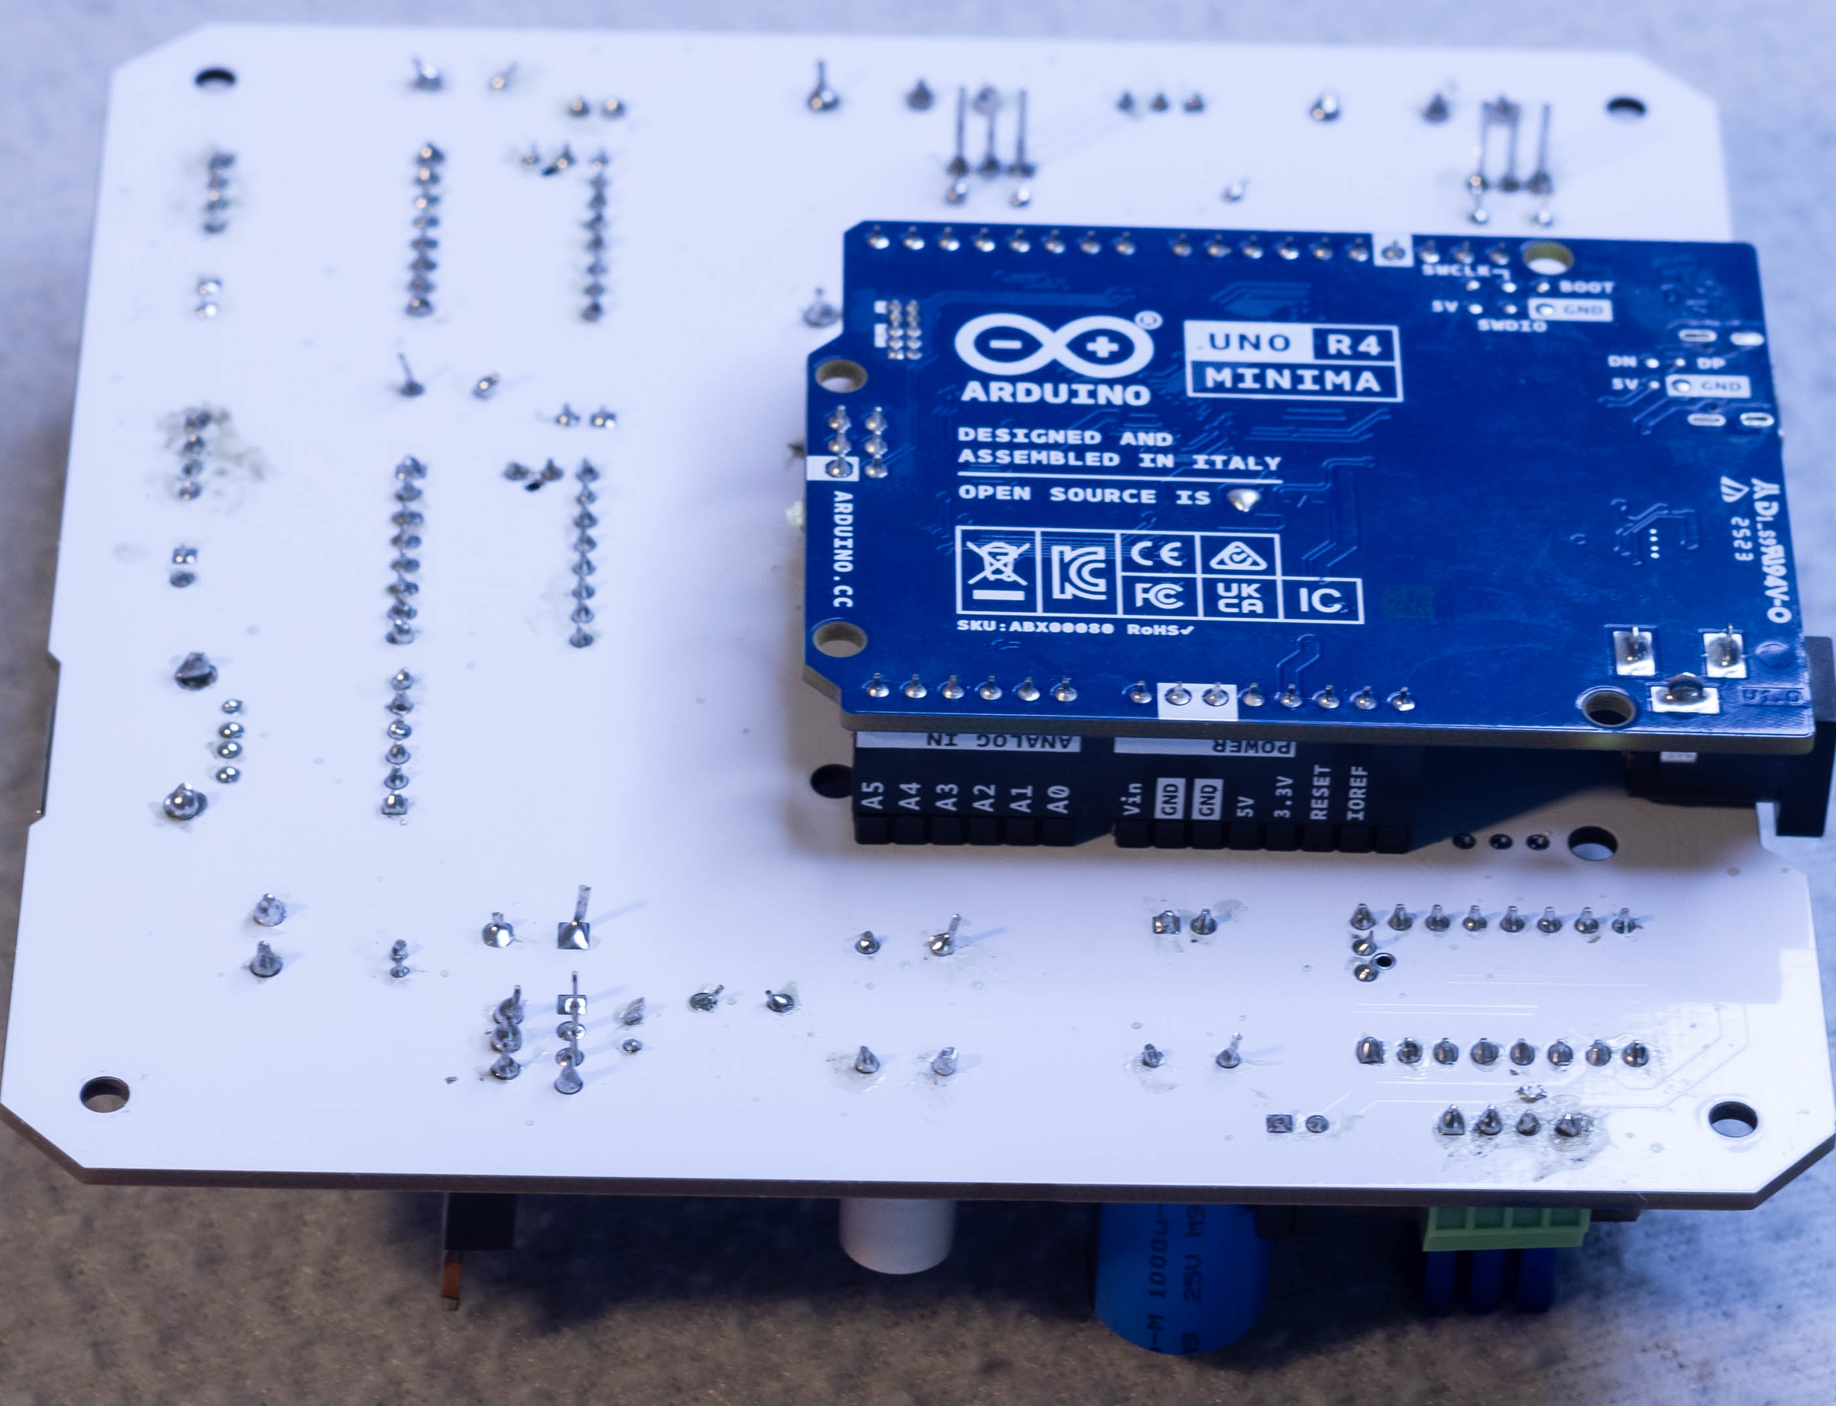
Step 7 – optic holder
Focus rail – foot x2
M4 Heat set insert x2
M4x10mm x4

Slide 12
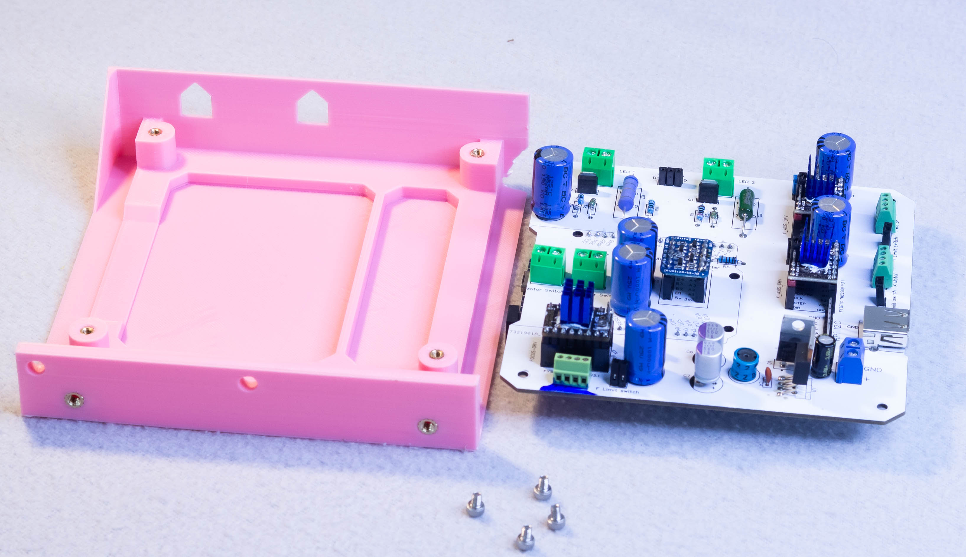
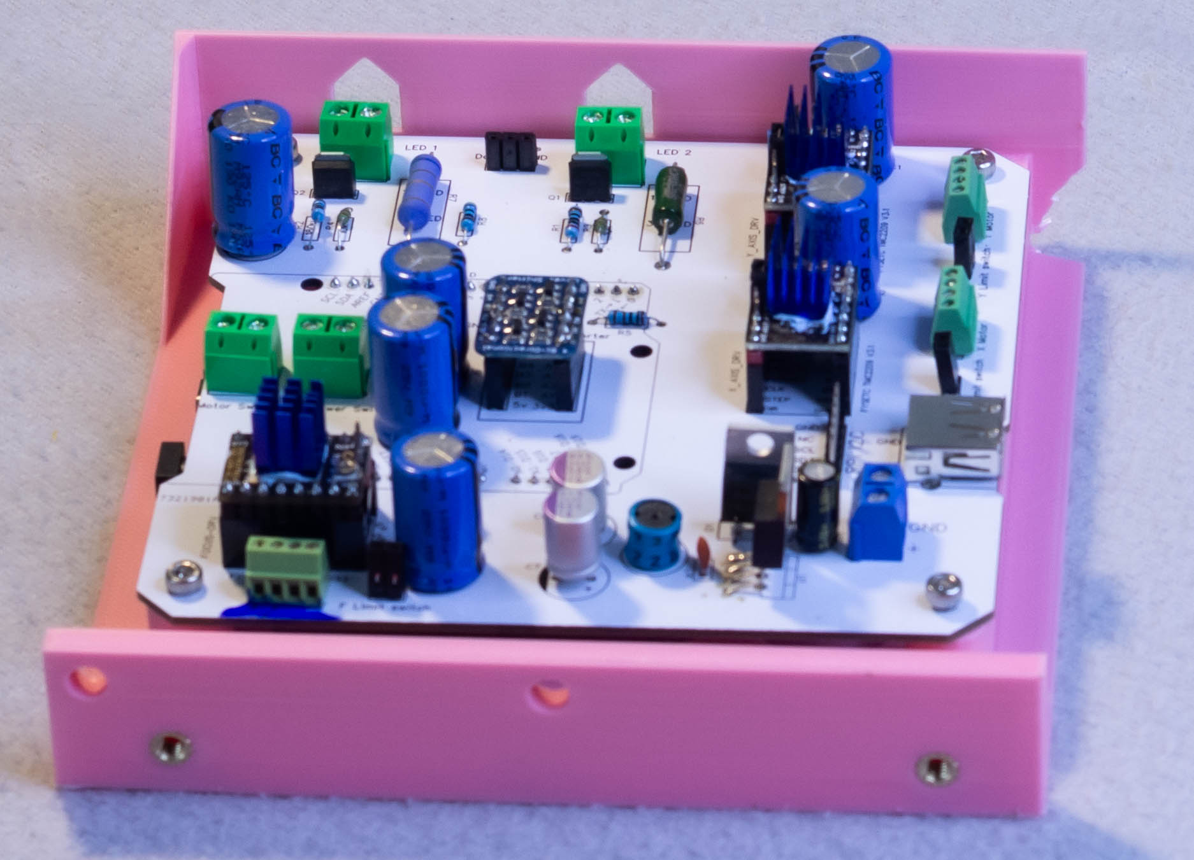
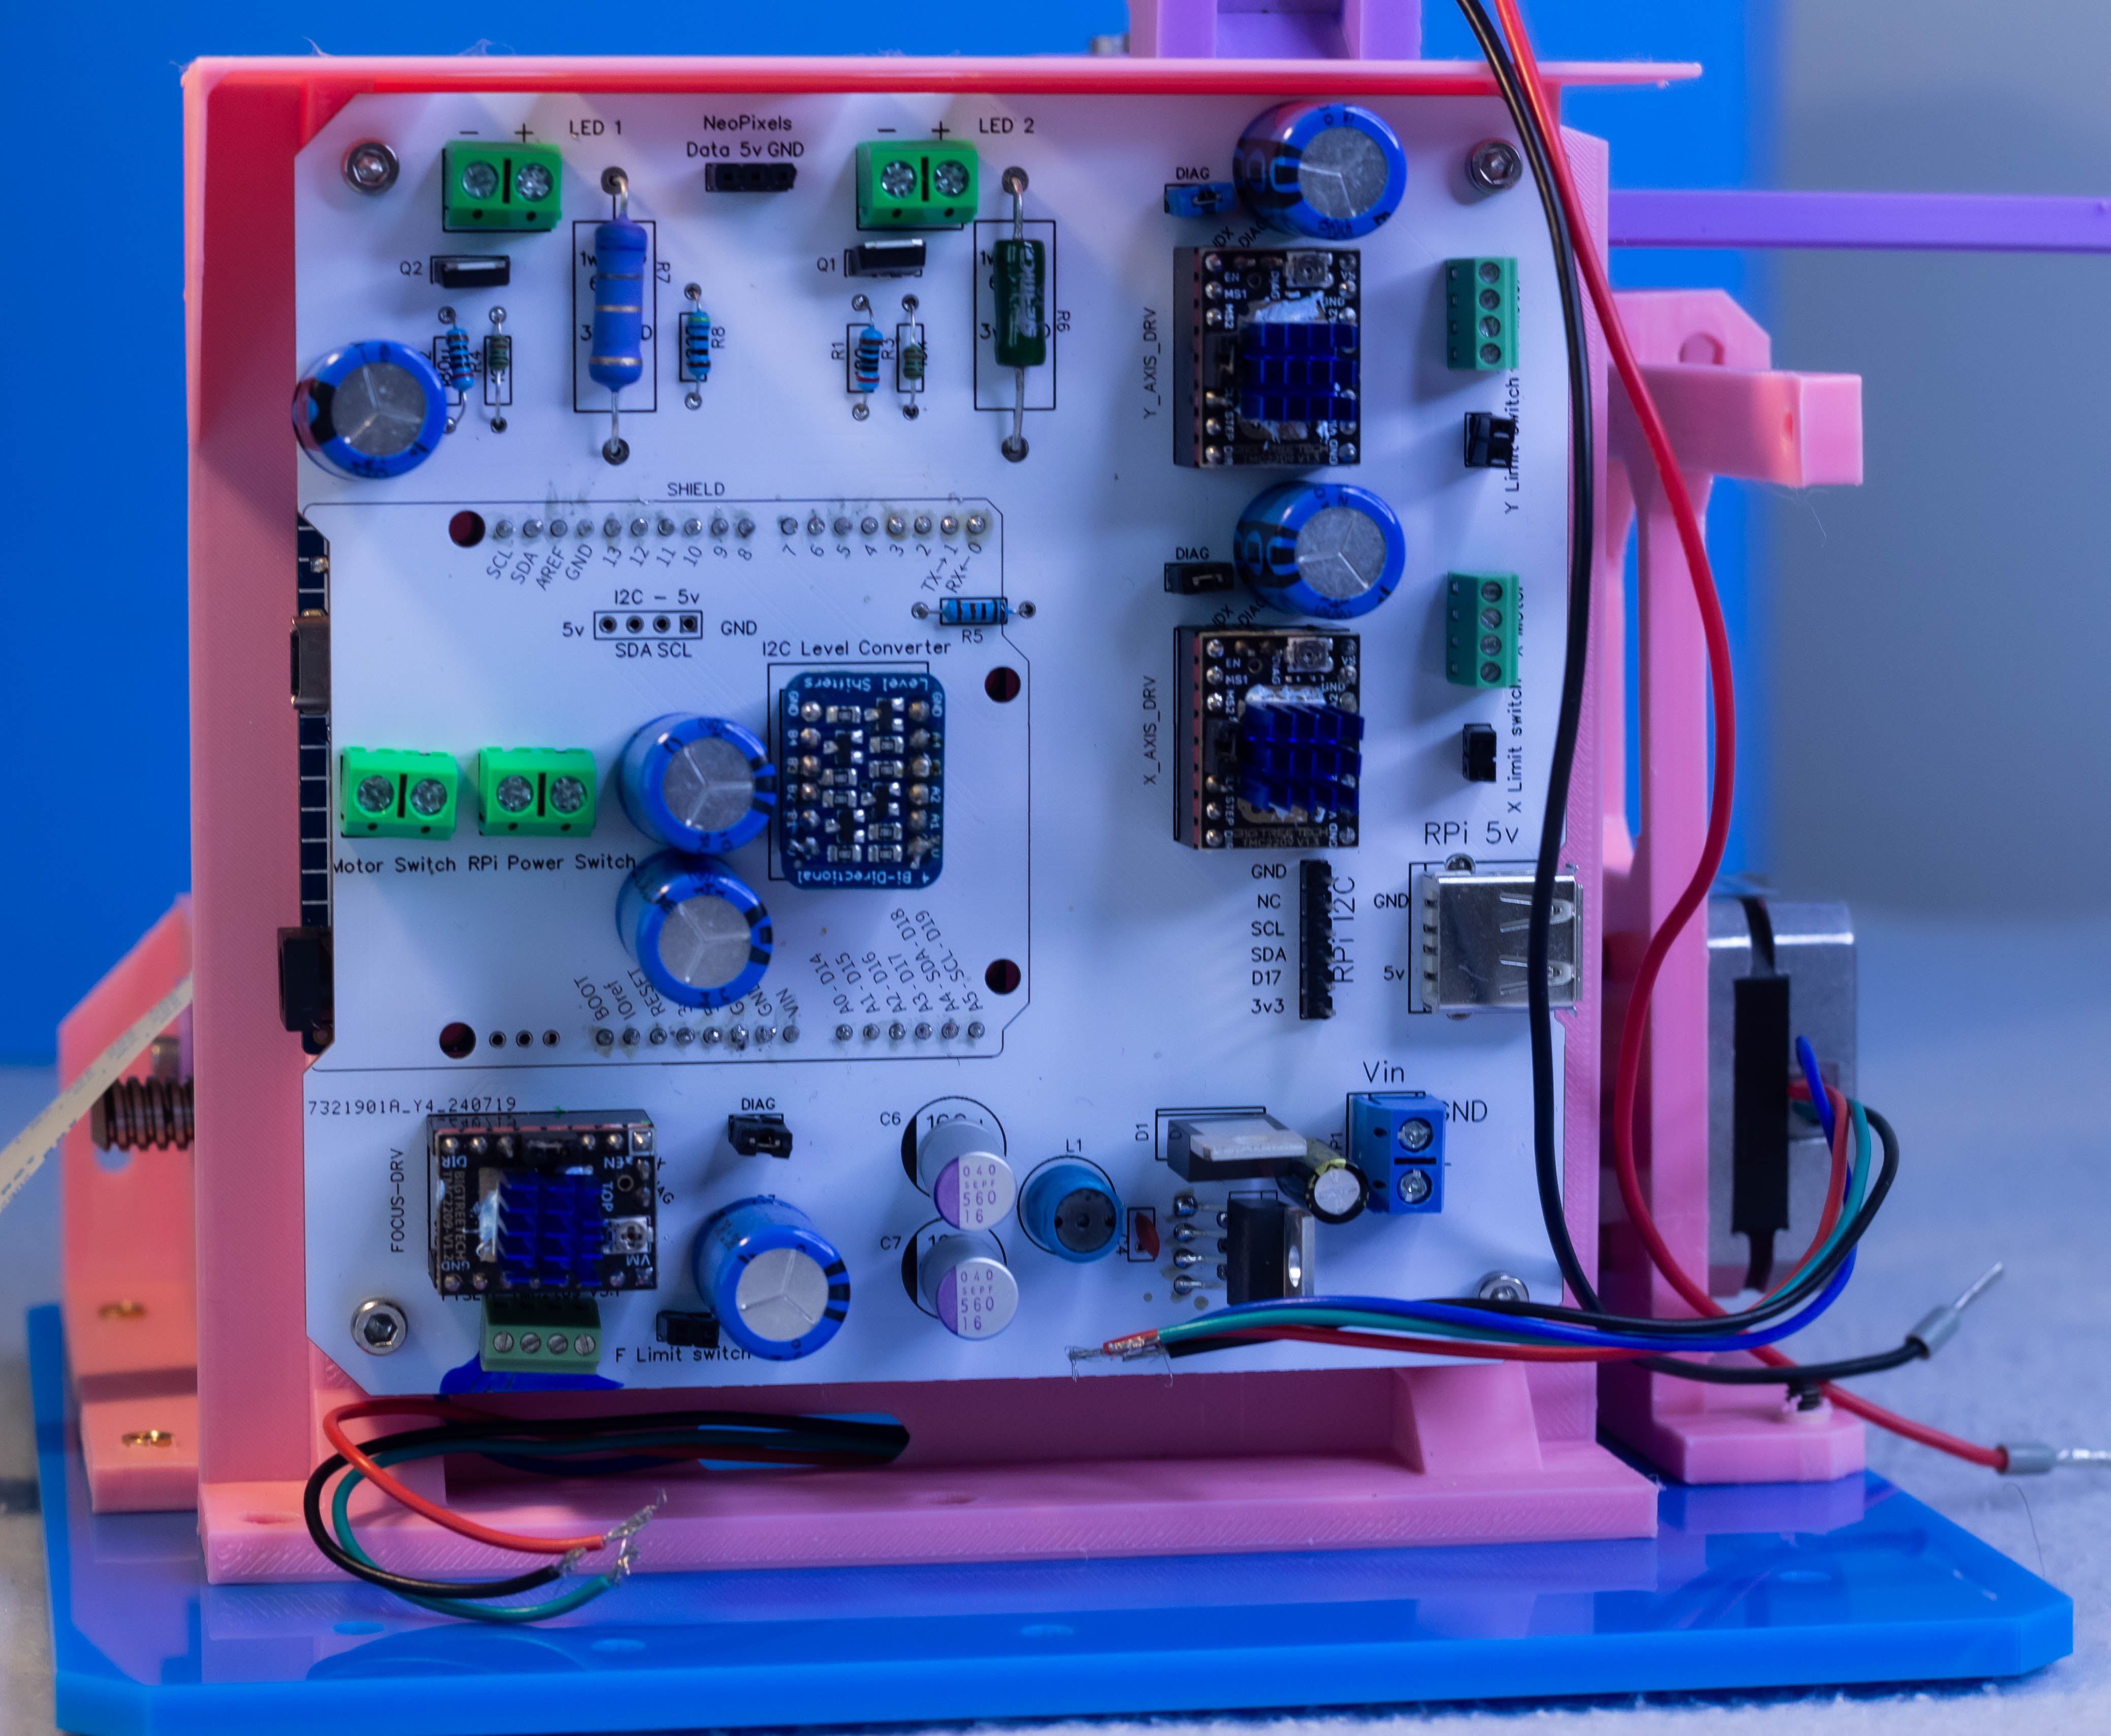
Step 7 – optic holder
Focus rail – foot x2
M4 Heat set insert x2
M4x10mm x4

Slide 13
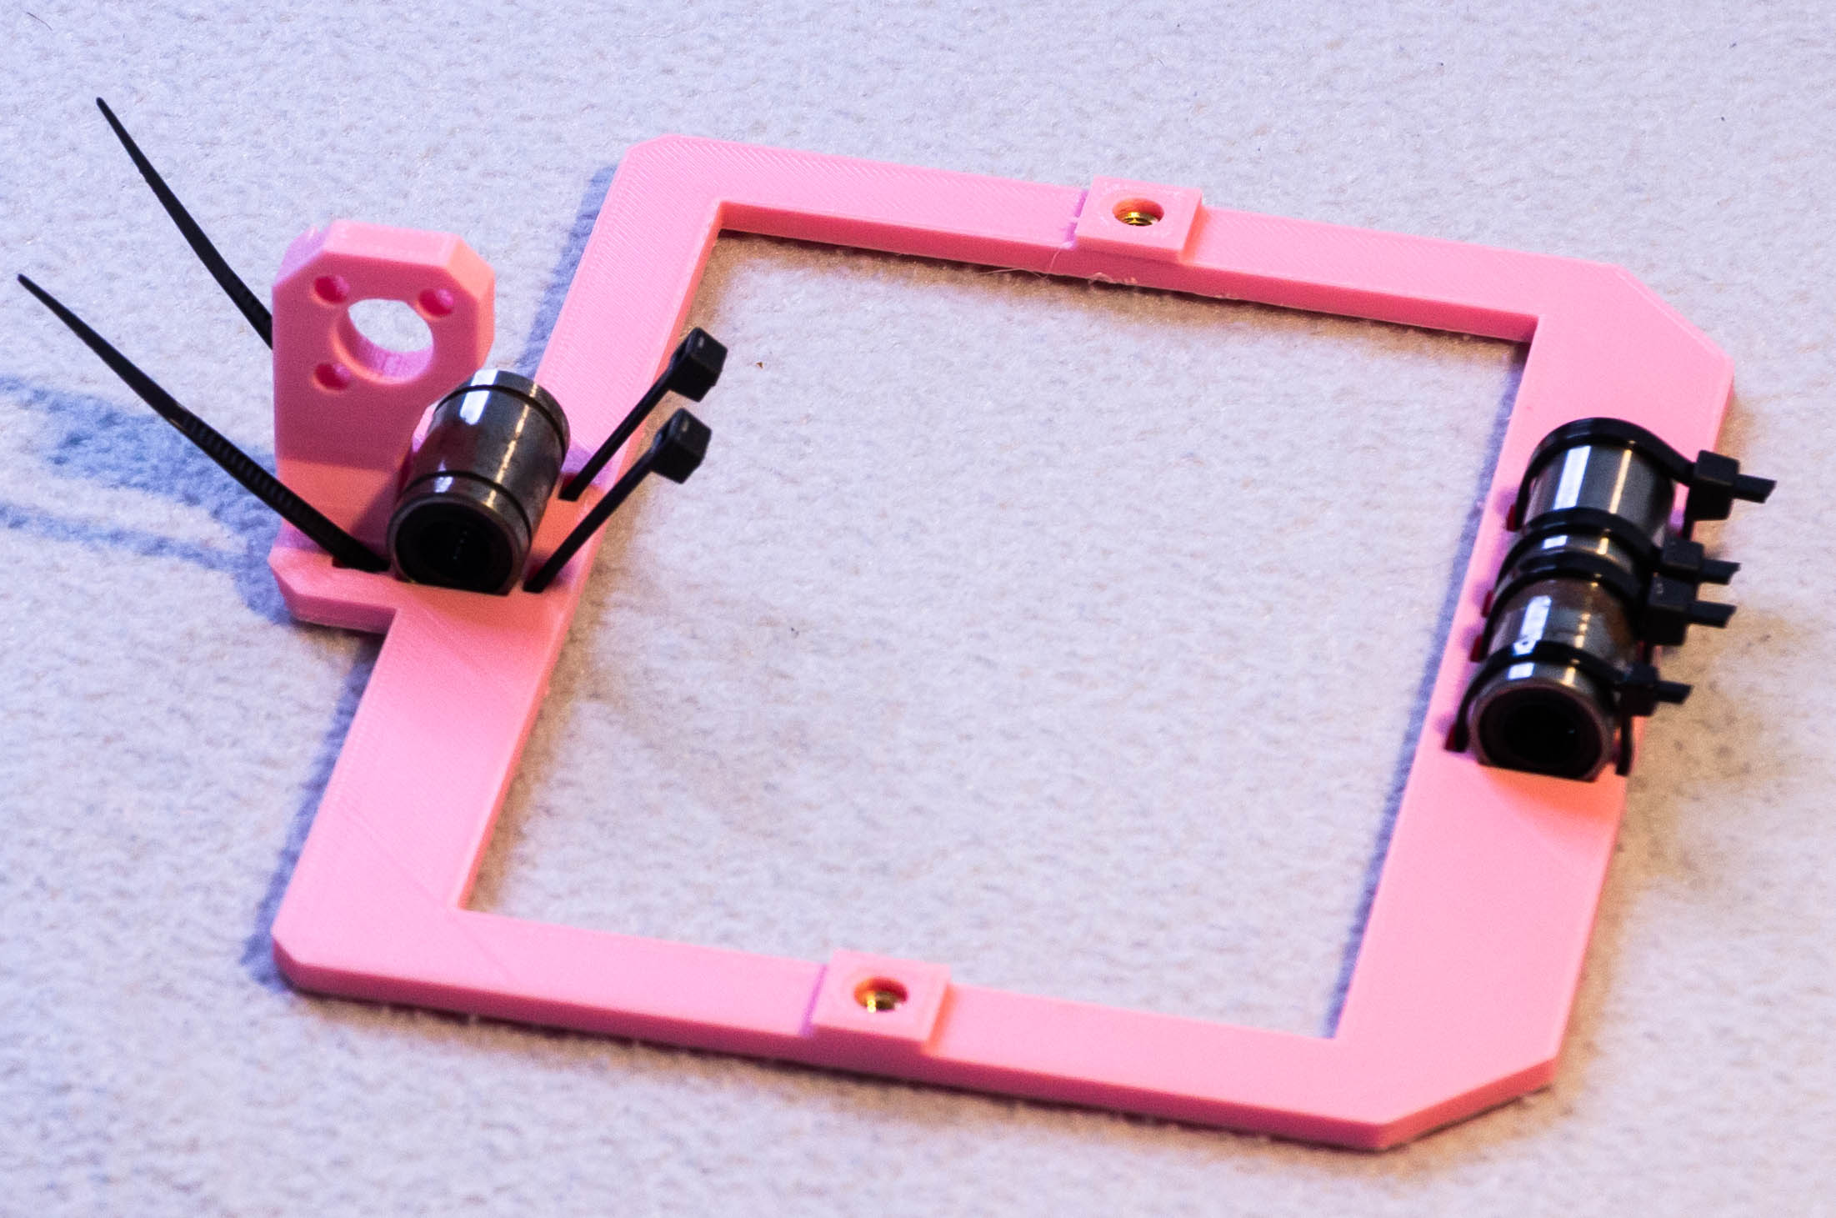
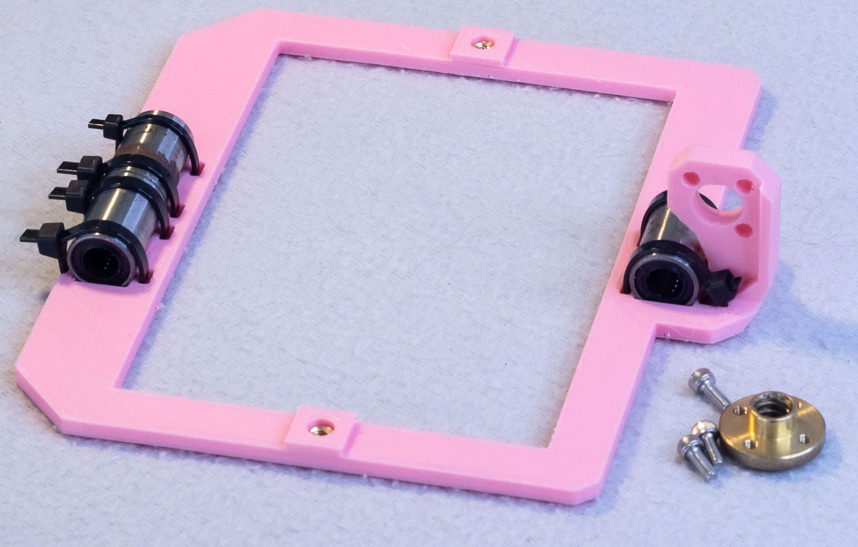
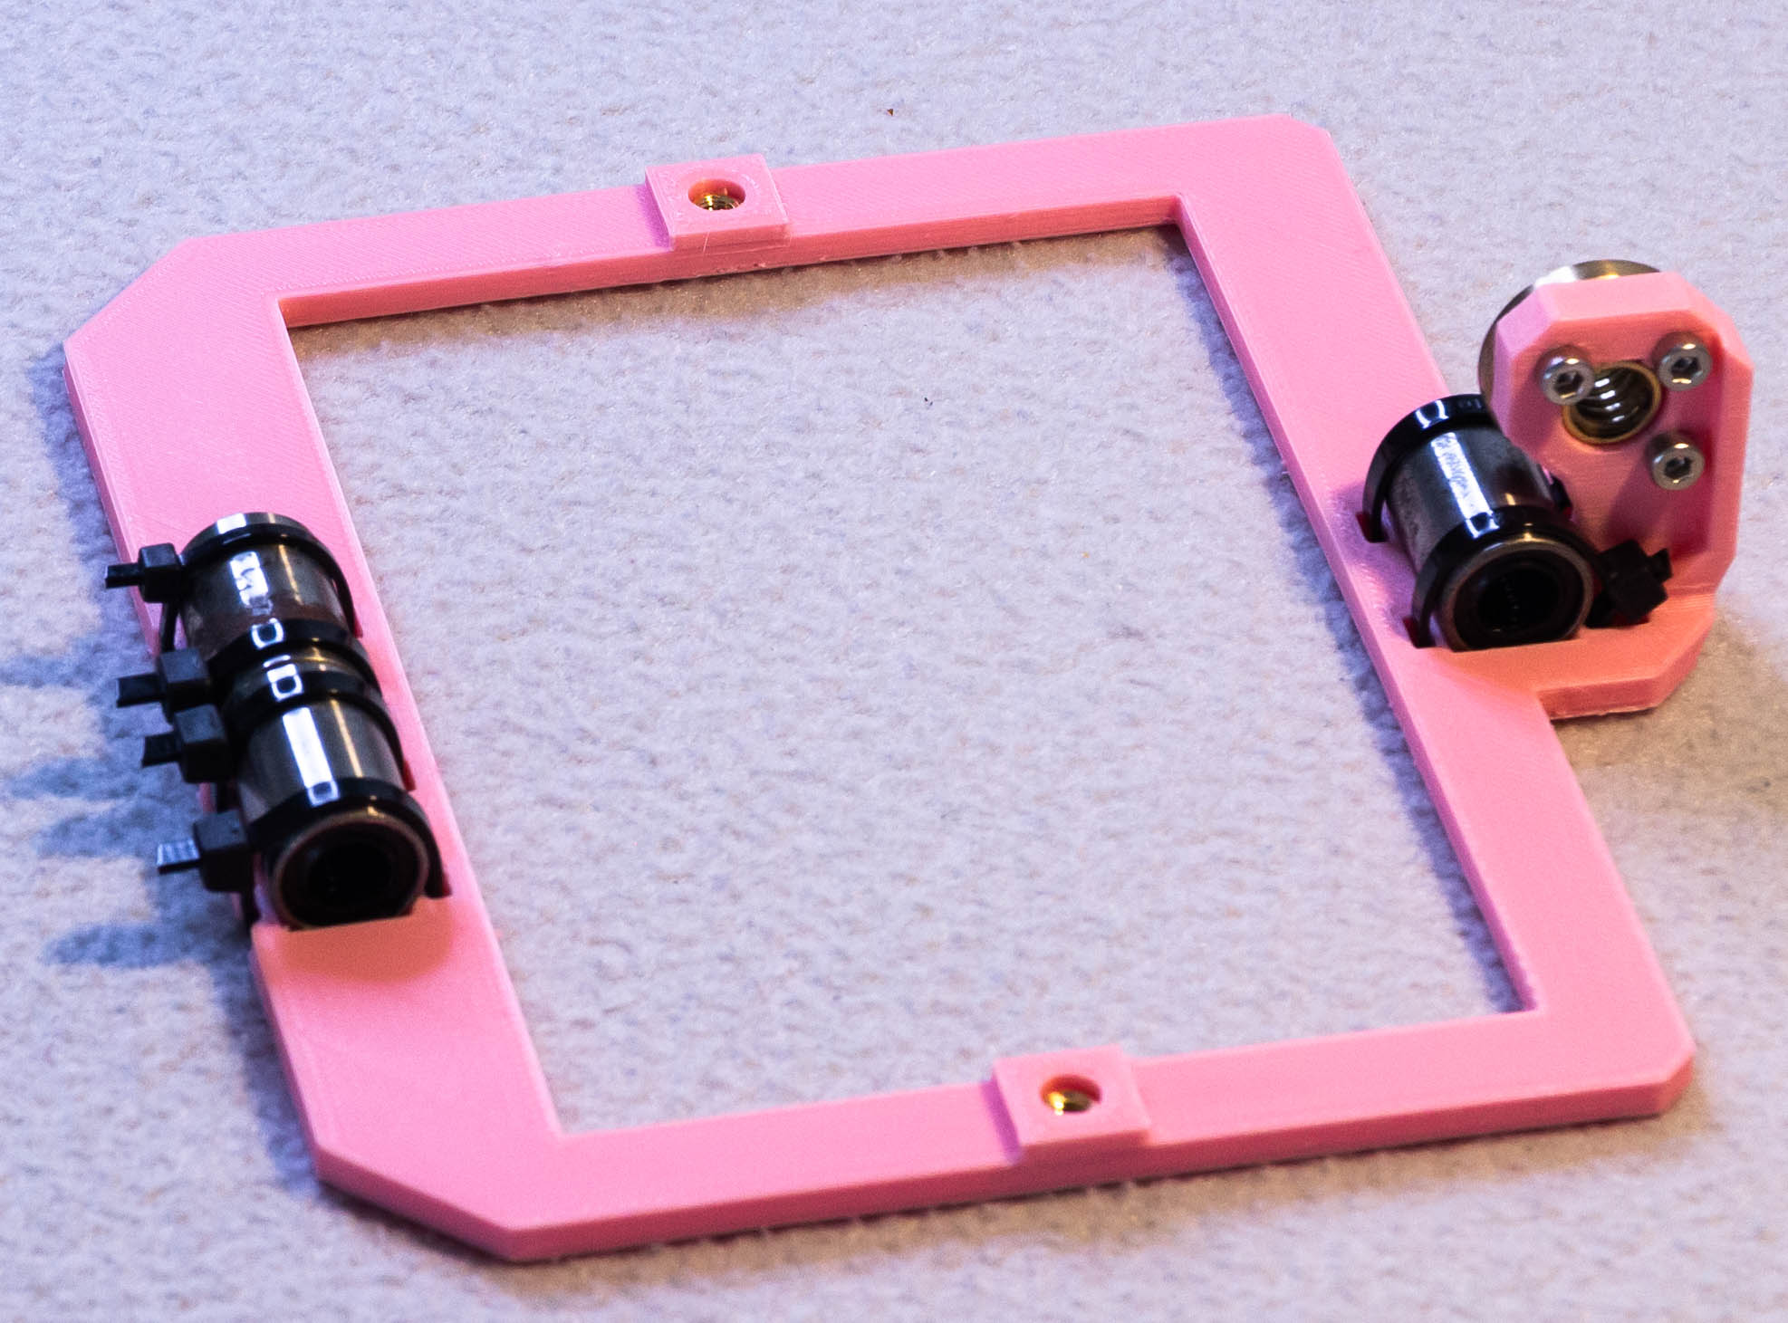
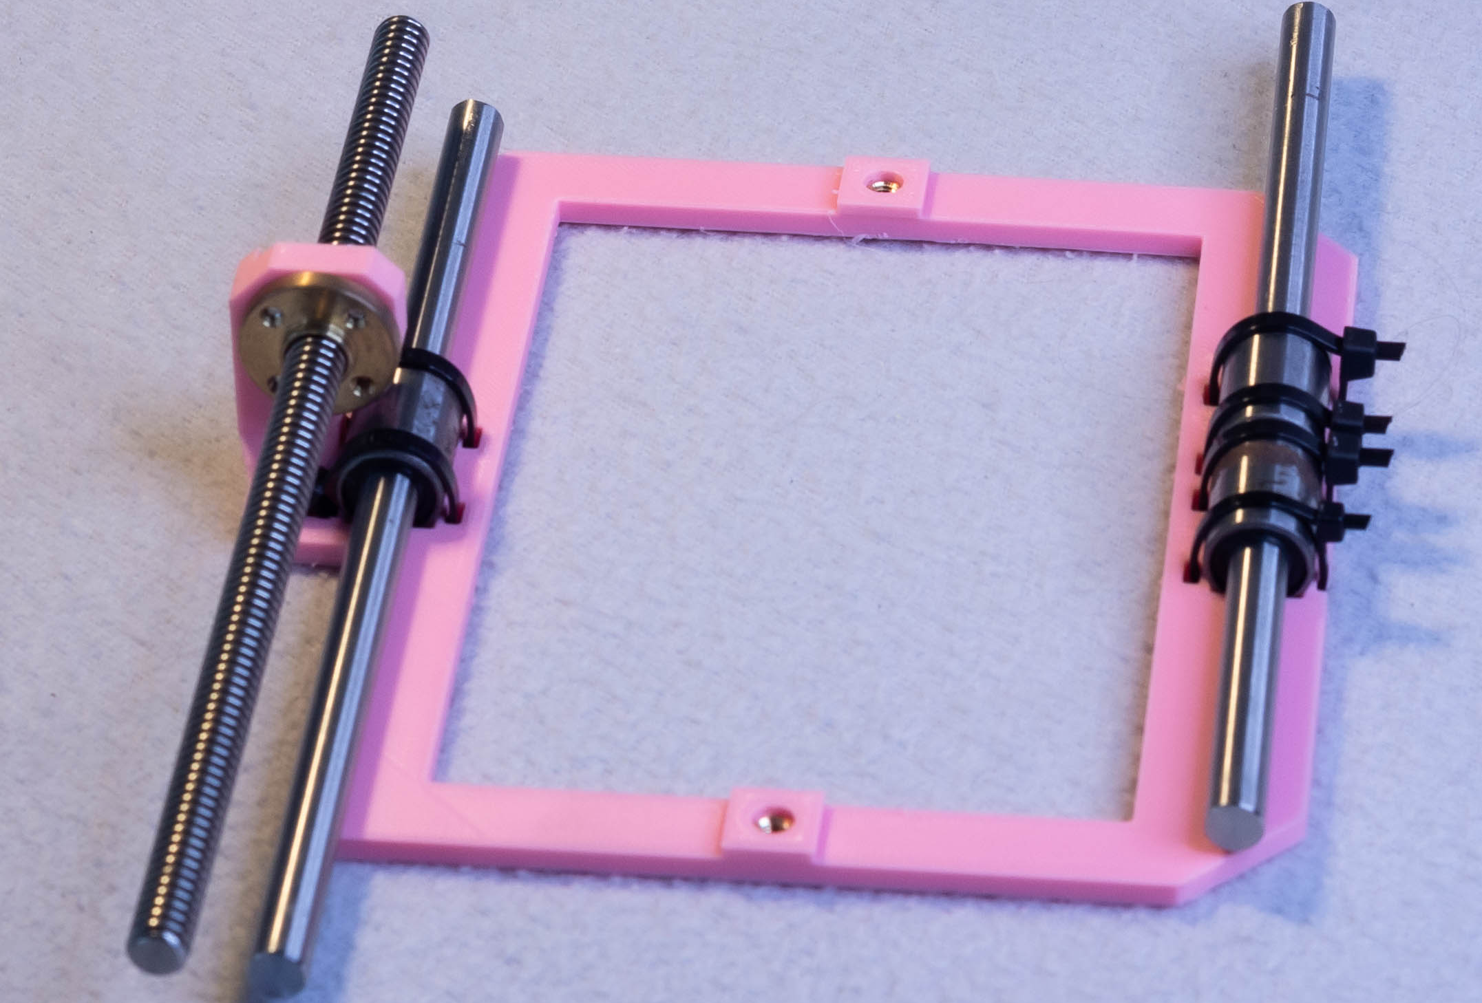
Step 7 – optic holder
Focus rail – foot x2
M4 Heat set insert x2
M4x10mm x4

Slide 14
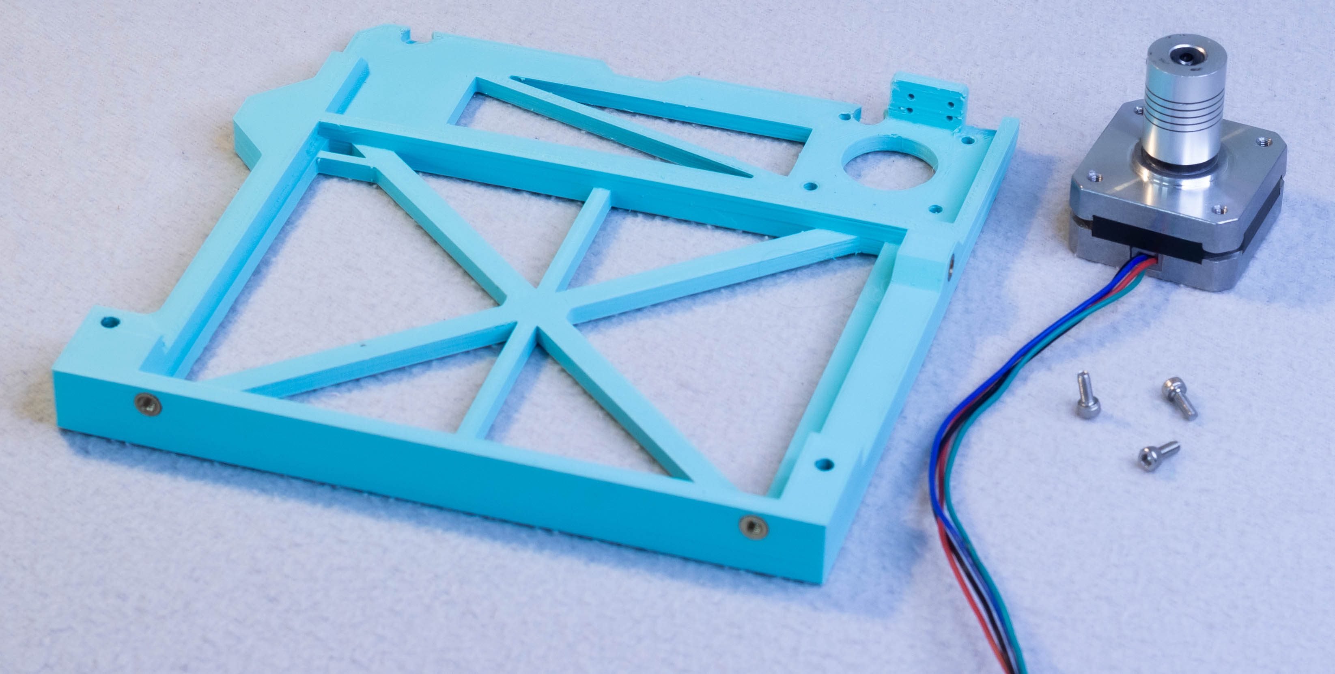
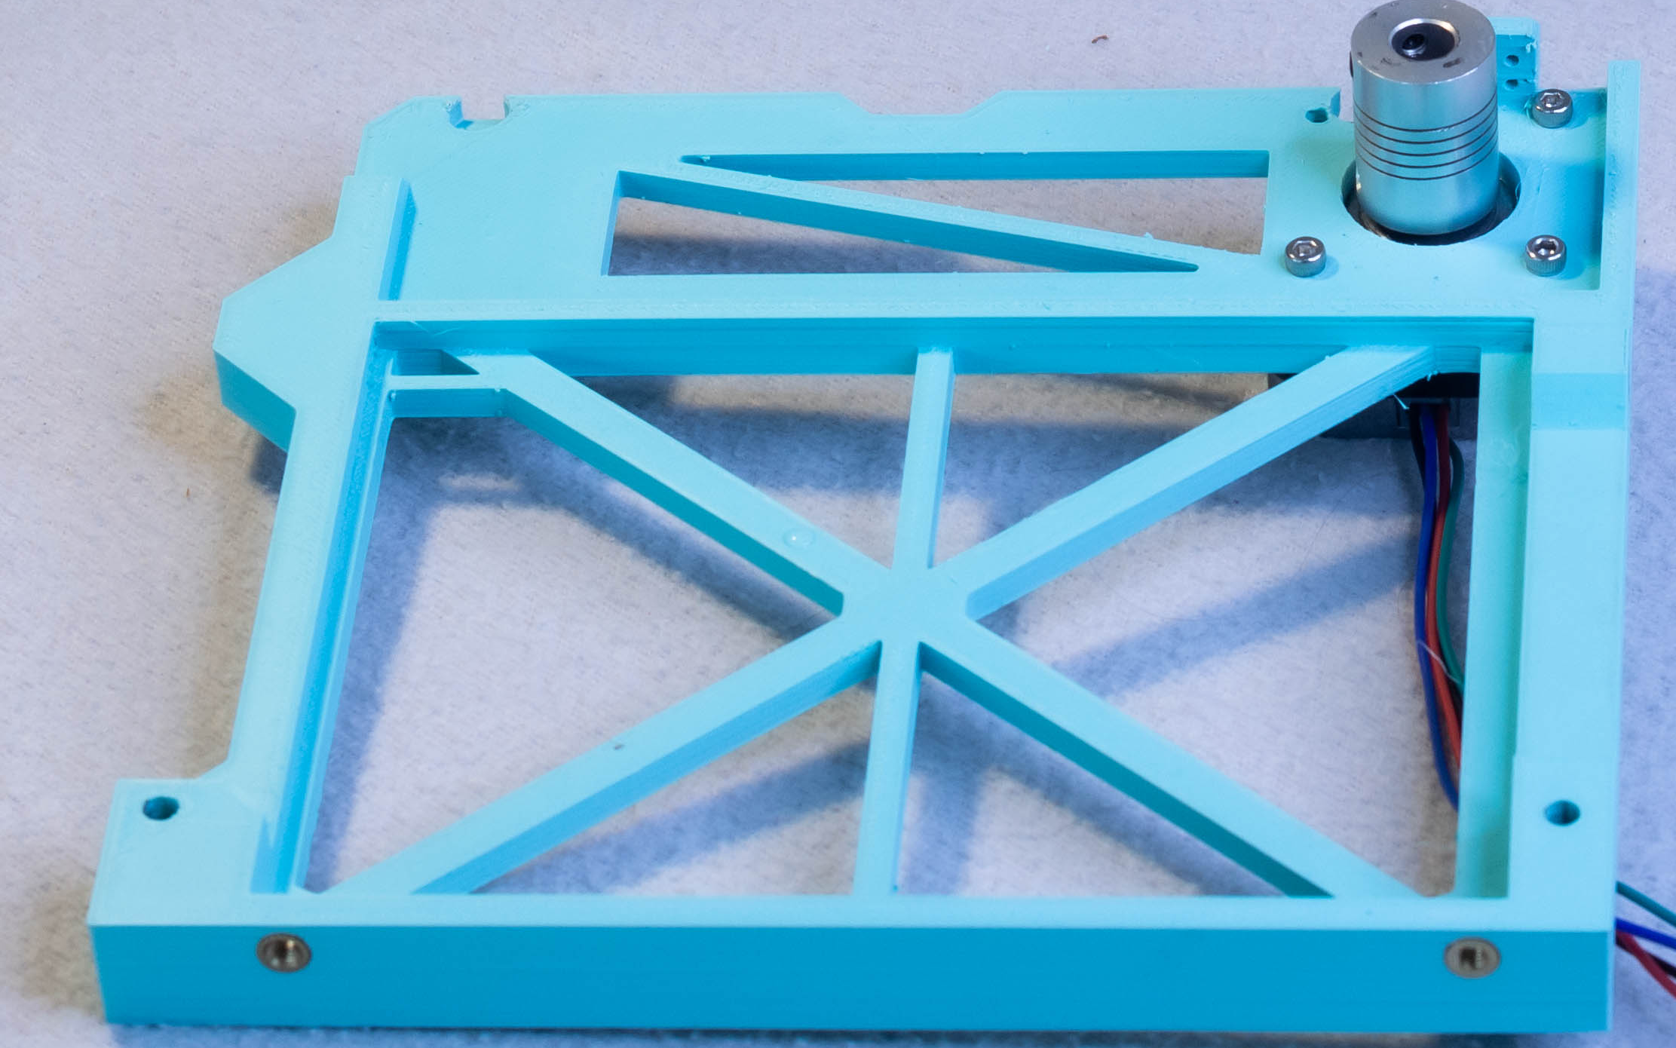
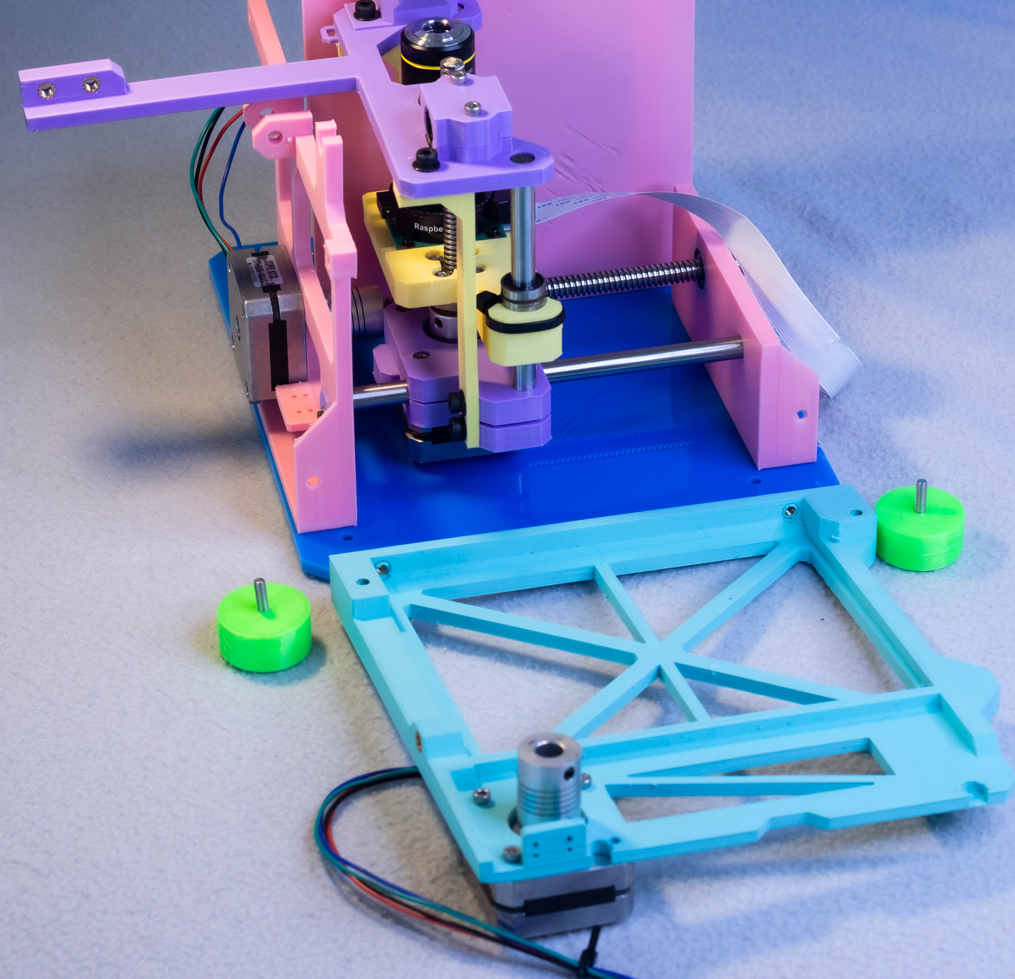
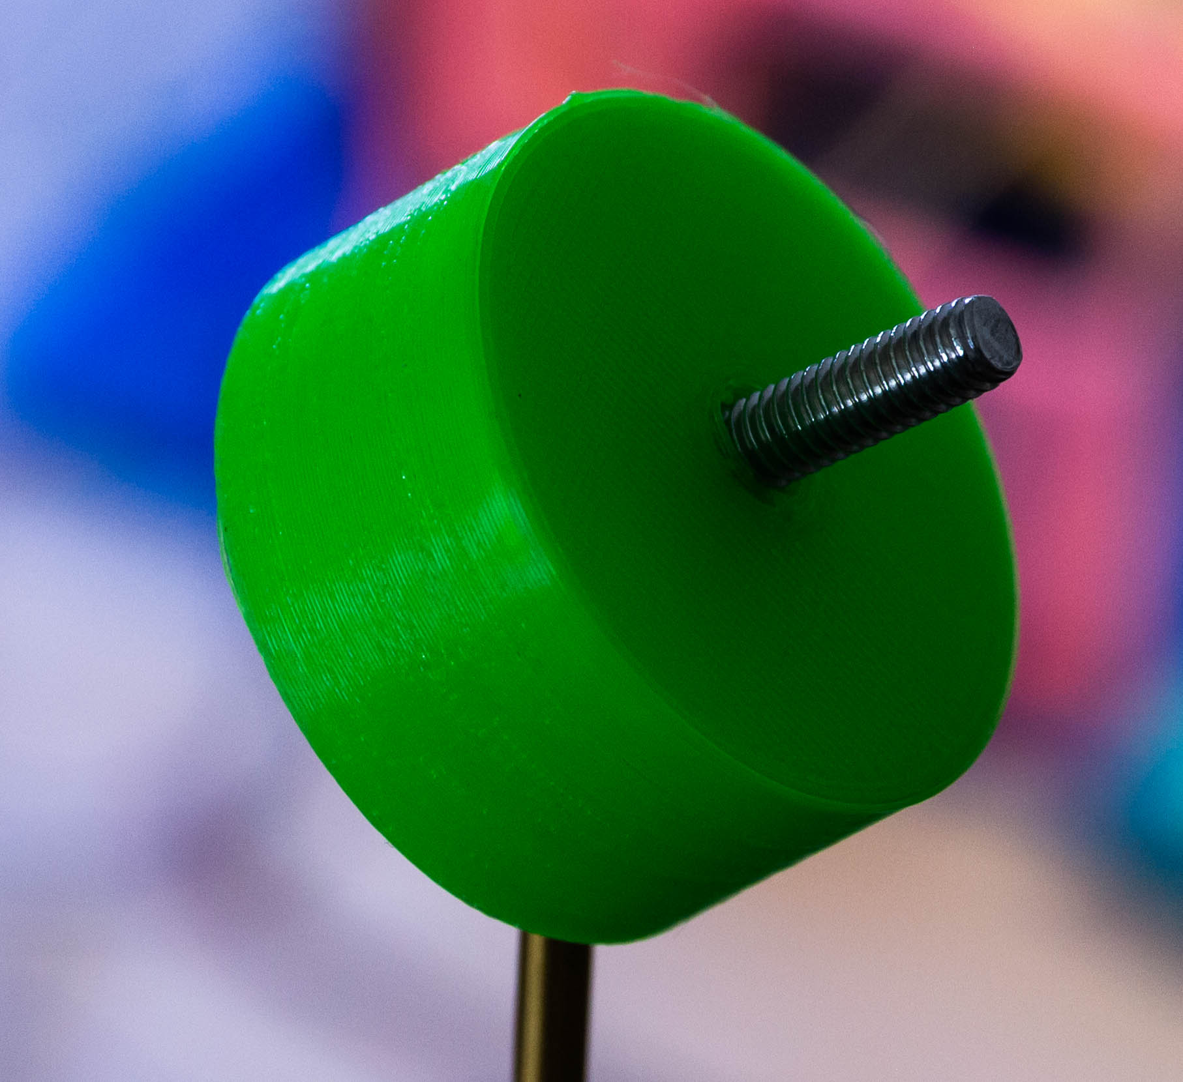
Step 7 – optic holder
Focus rail – foot x2
M4 Heat set insert x2
M4x10mm x4

Slide 15
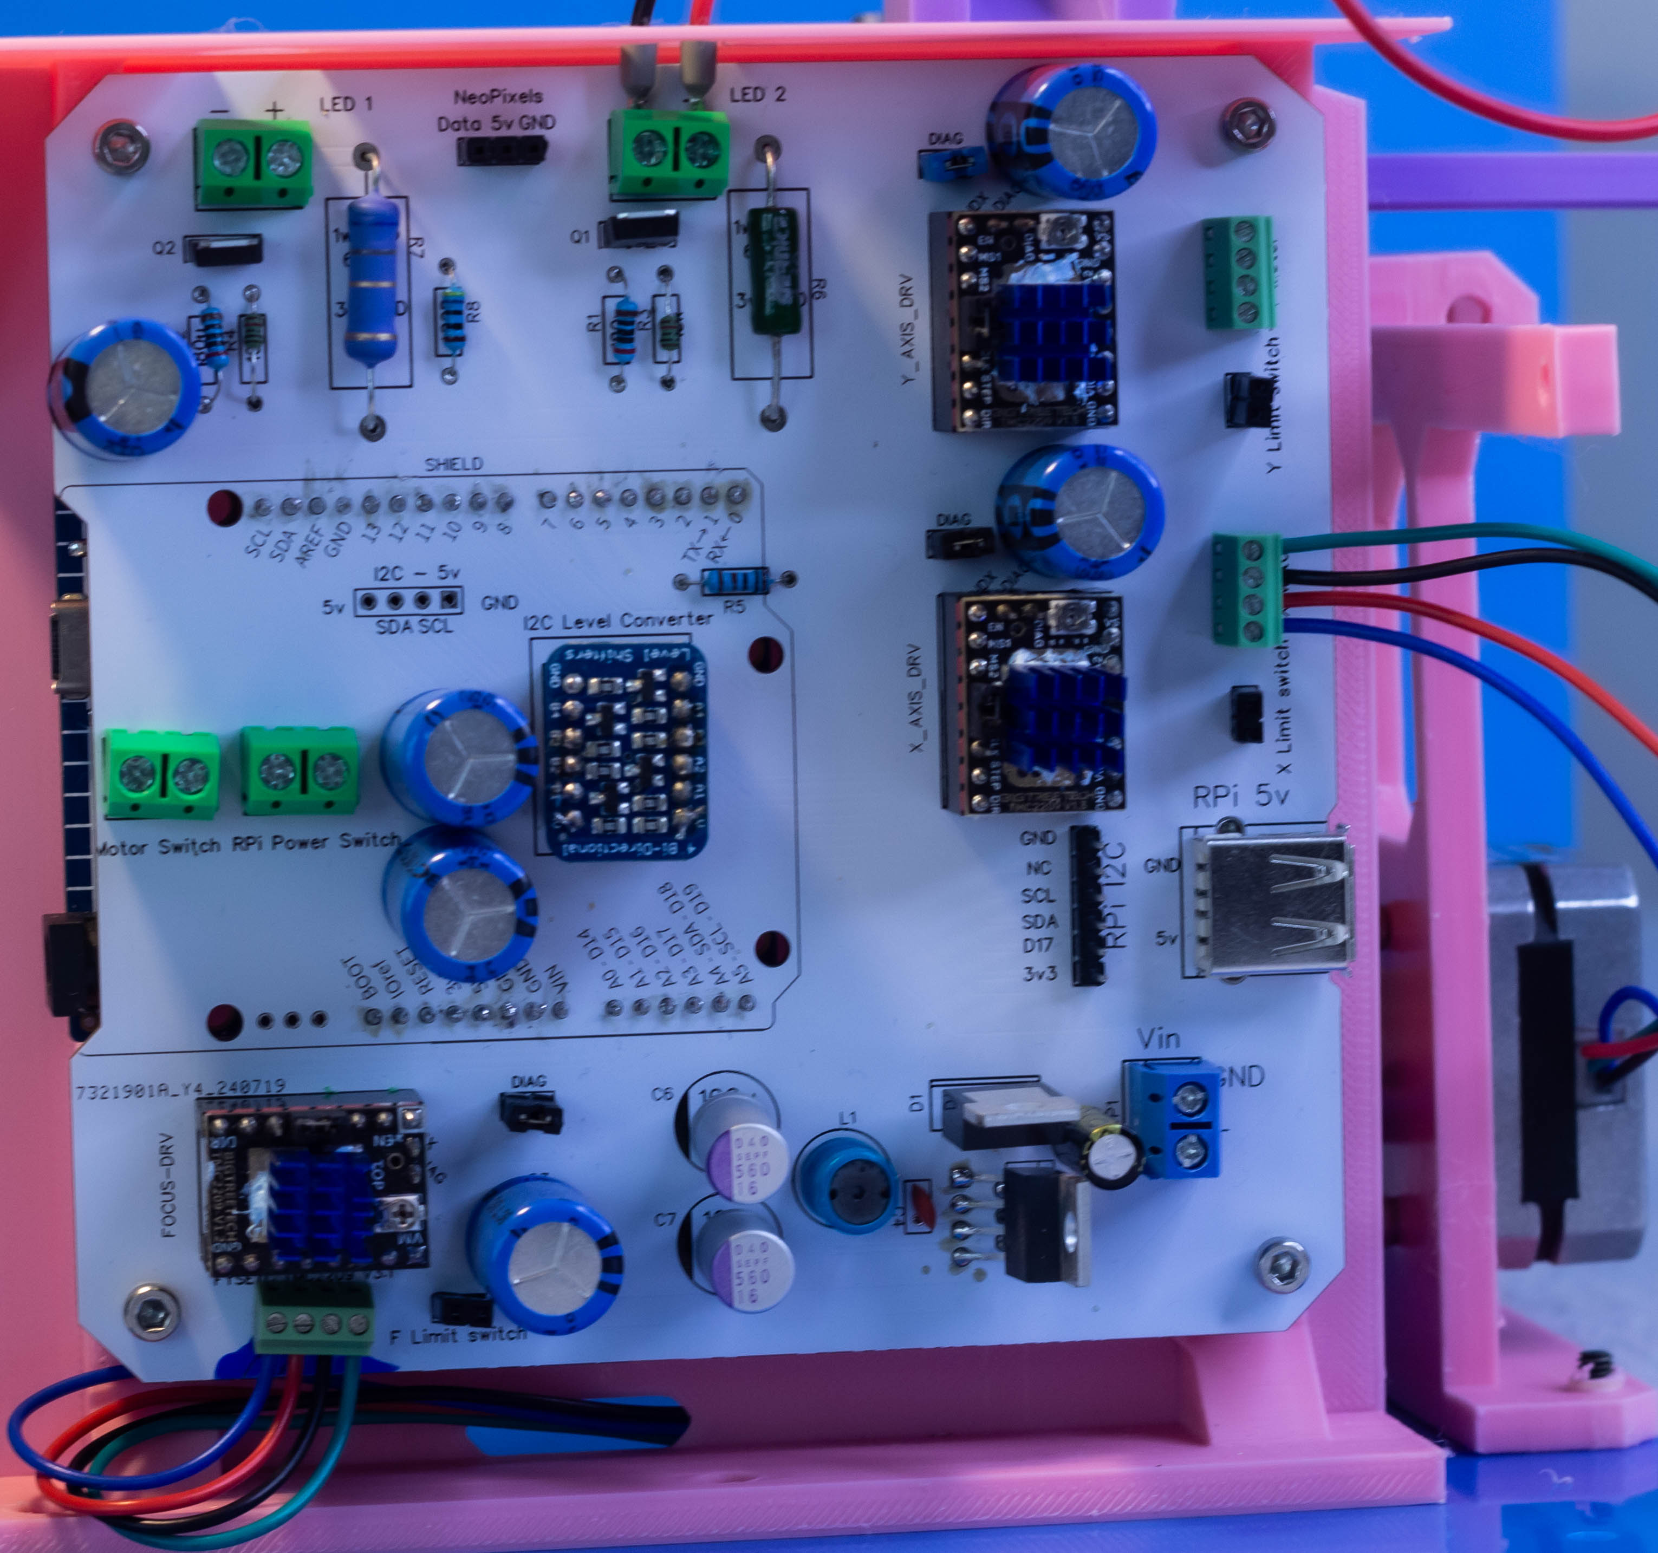
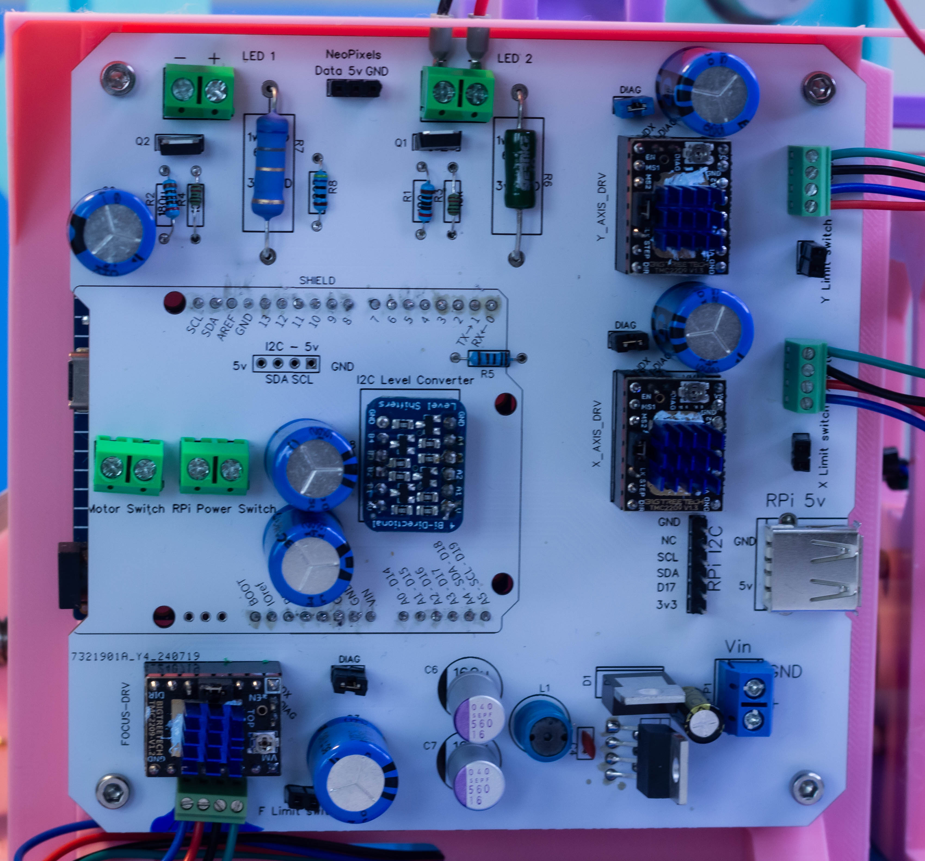

Slide 16
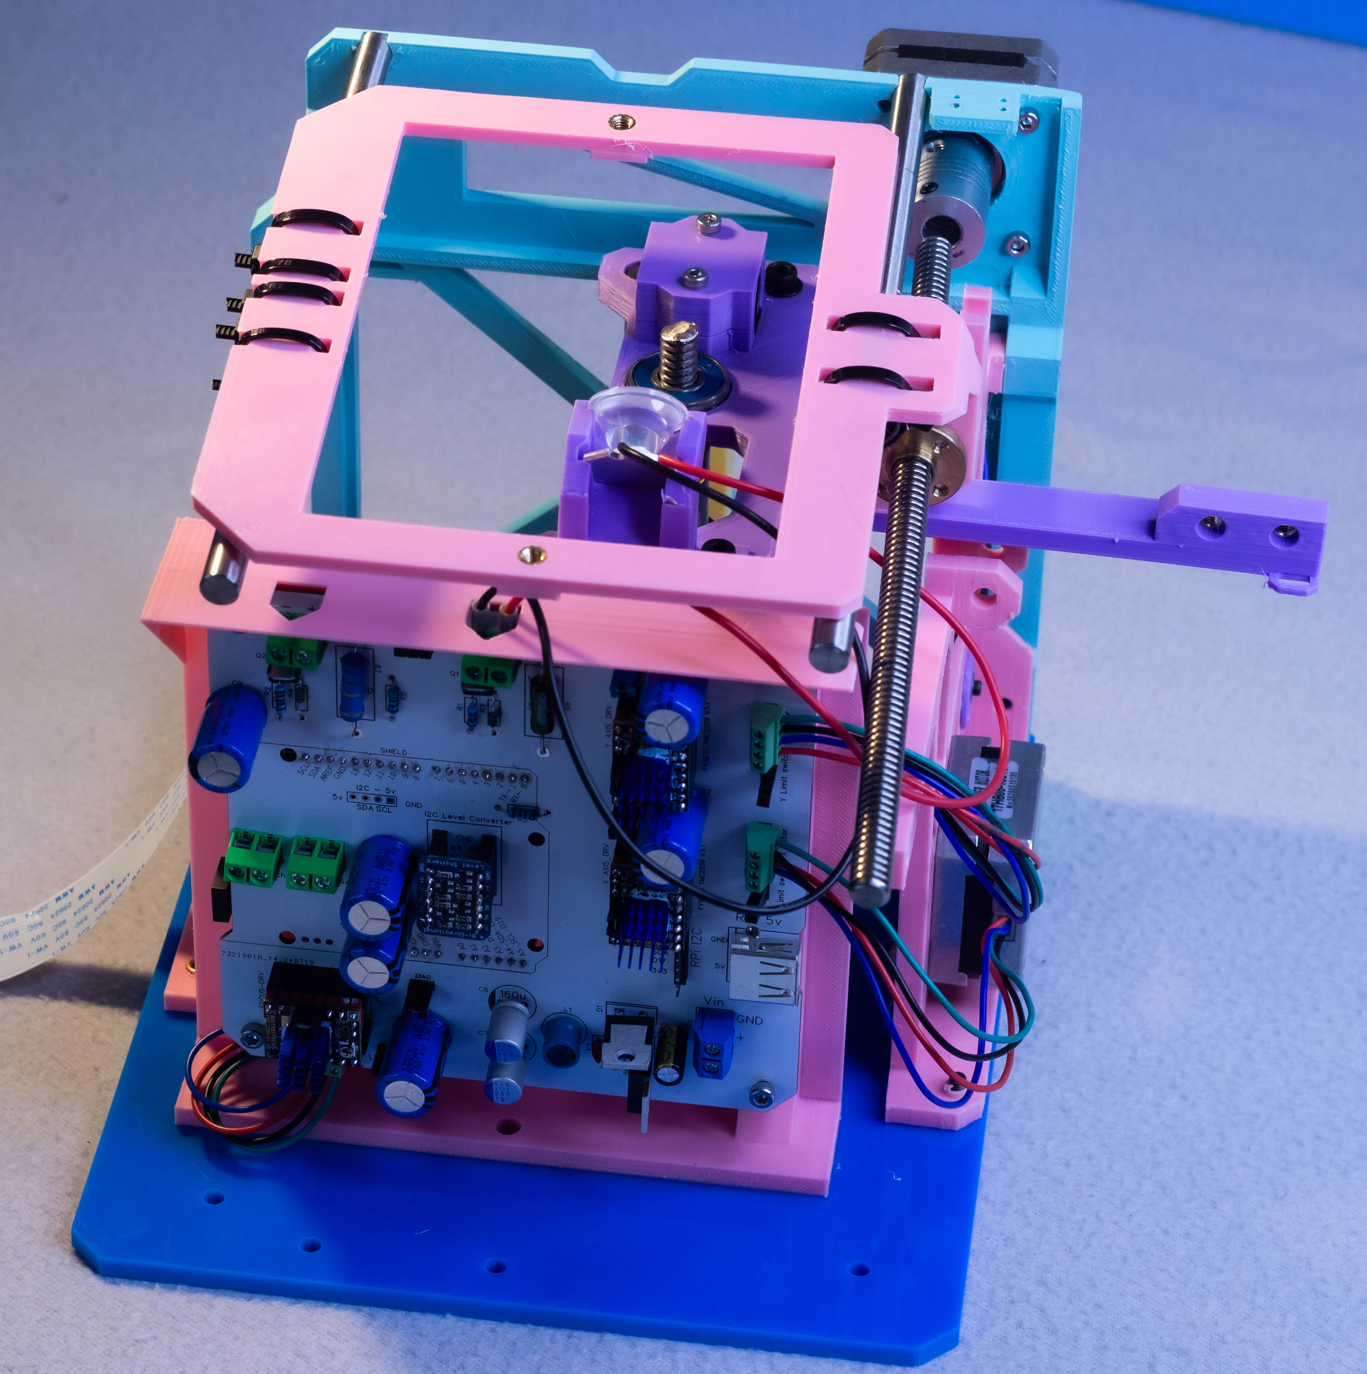
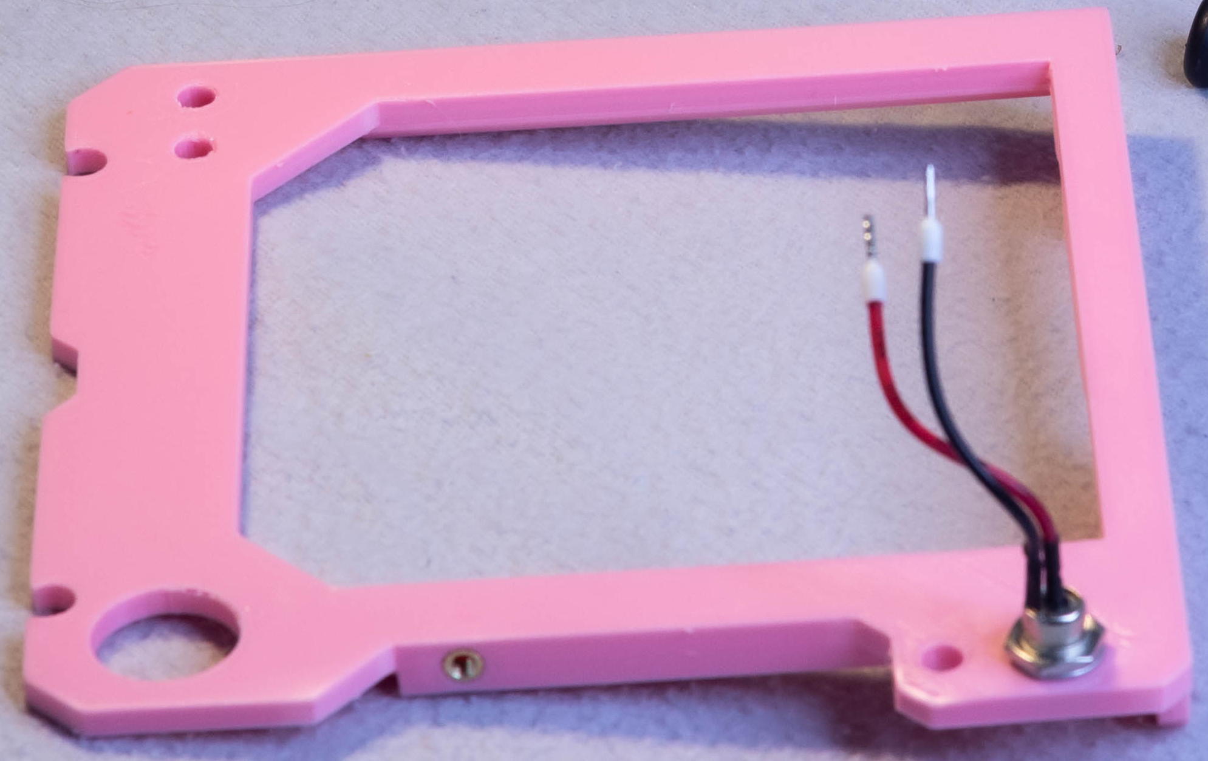
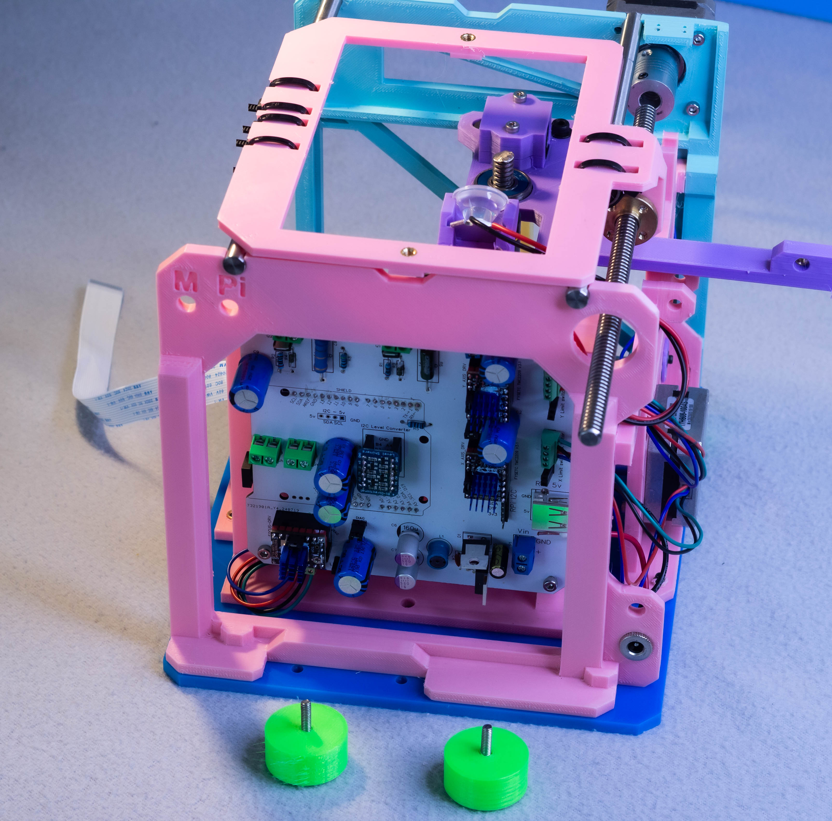
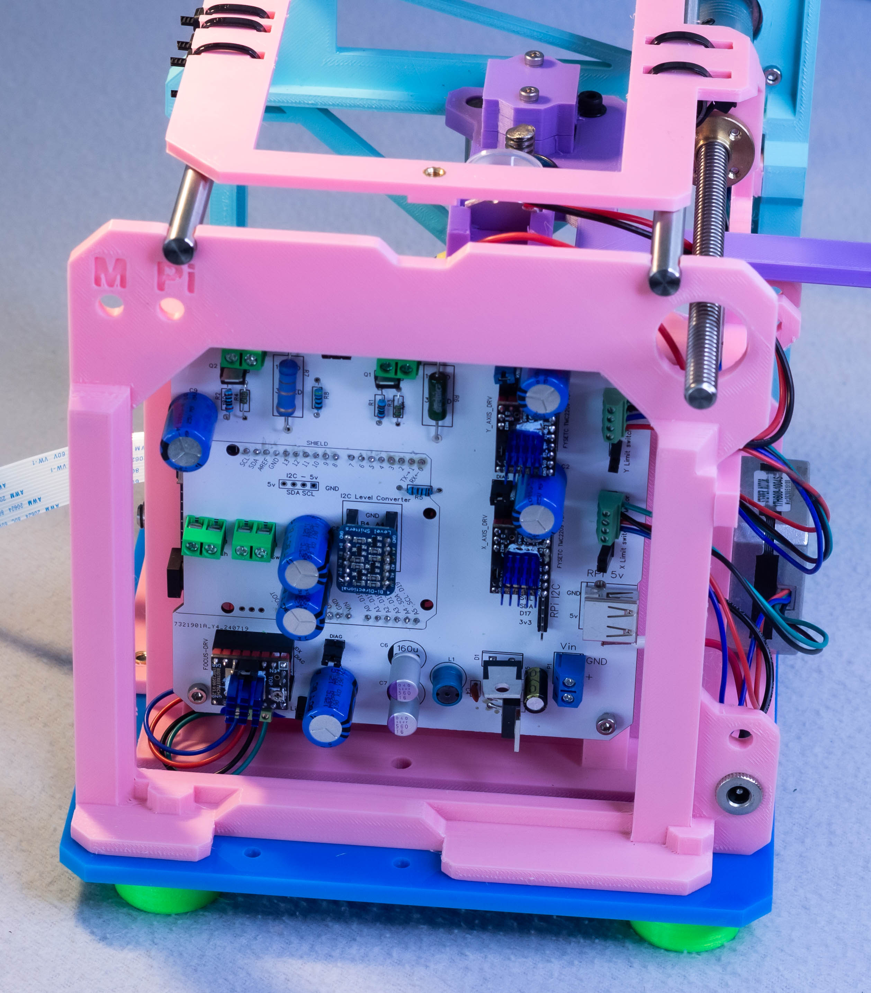
Step 7 – optic holder
Focus rail – foot x2
M4 Heat set insert x2
M4x10mm x4

Slide 17



Step 7 – optic holder
Focus rail – foot x2
M4 Heat set insert x2
M4x10mm x4

Slide 18


Step 7 – optic holder
Focus rail – foot x2
M4 Heat set insert x2
M4x10mm x4

Slide 19


Step 7 – optic holder
Focus rail – foot x2
M4 Heat set insert x2
M4x10mm x4

Slide 20




Step 7 – optic holder
Focus rail – foot x2
M4 Heat set insert x2
M4x10mm x4

Slide 21


Step 7 – optic holder
Focus rail – foot x2
M4 Heat set insert x2
M4x10mm x4

